Slide 1
Welcome

Slide 2
Judith Matsko
Board Chair
Notes:
Good Morning Girl Scouts!
My name is Judith Matsko and I am the Board Chair of the Girl Scouts of North East Ohio.
Welcome to Part 2 of the Annual Meeting of the General Assembly., which is now called to order.
I hope all of you and your families are staying safe and staying healthy. It has been quite a hear as we have navigated through the pandemic. We are Girl Scouts and remain resilient.
We are in a Zoom Webinar. Panelist are able to speak. Participants can ask questions or make comments via the question log. Staff will be monitoring the Question Log and panelist will address questions during the Q & A session after all the presentations have been made. The webinar will be recorded.

Slide 3
Call to Order
Notes:
Judy:
This meeting is Called to Order

Slide 4
Girl Scout Promise and Law
Girl Scout Promise
On my honor, I will try:
To serve God and my country,
To help people at all times,
And to live by the Girl Scout Law
Girl Scout Law
I will do my best to be
Honest and fair,
Friendly and helpful,
Considerate and caring,
Courageous and strong, and
Responsible for what I say and do,
And to
Respect myself and others,
Respect authority,
Use resources wisely,
Make the world a better place, and
Be a sister to every Girl Scout.
Notes:
Judy: Since we are conducting today’s meeting virtually, two of our Girl Members – Shelby Bennett and Sydney Harbour will lead us in the Girl Scout Promise and Law.

Slide 5
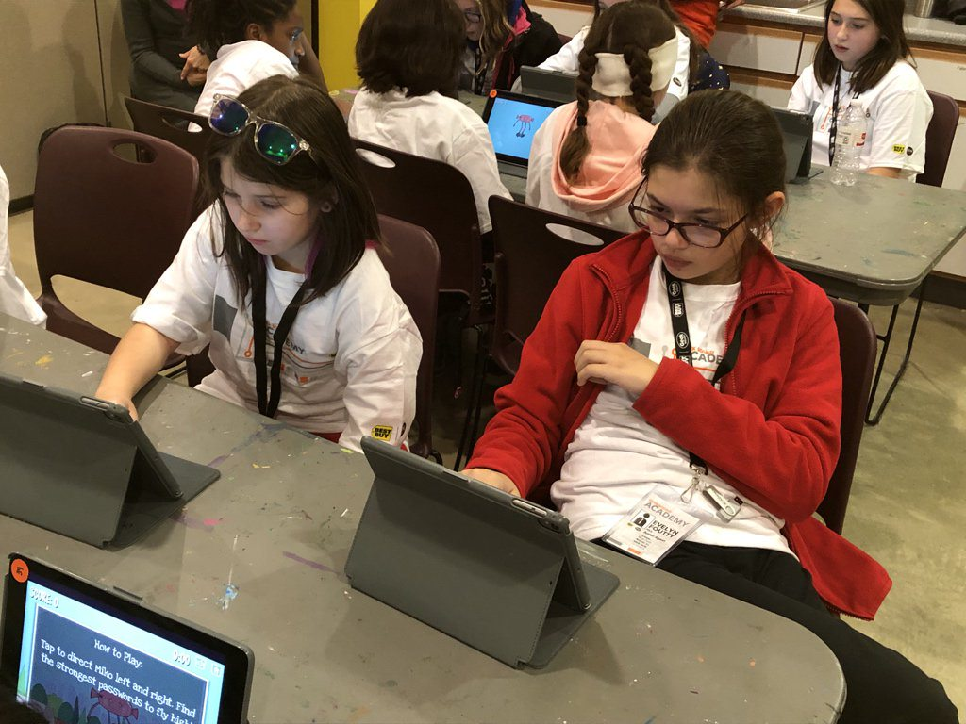
Thank You
Board of Directors
Board Development Committee
Jane Christyson, CEO
Membership Delegates
National Delegates
Notes:
I would like to thank: Board of Director – Chris Venditti, Vice Chair; Cindy Skelton-Becker, Secretary and Kate Asbeck, Treasurer and Directors-at-Large: Allison Baker, Dr. Diana Bilimoria, Robyn Gordon, Joseph Gutkoski, Matt Inks, Kathy Moock,
Dr. Mary Parker, Sandra Rapp, Nicole Rodenfels, Laura Schultz, Dr. Karen Stock, Ellen Stephens, Chris Walker, Kristina Wilson and Christine Young and our Girl Board of Directors: Charity Boley and Ava Kress.
We also express our gratitude to the hard work of the Board Development Committee – Kathy Moock, Chair; Erin Brady Curtis, Julie Cruz Blair, James Harris, Kaitlyn Pillar, Sandra Reid, Dr. Karen Stock, and Dr. Vivian von Gruenigen.
Our thanks to our National and Membership delegates who are the pulse and heartbeat of our Council.
On behalf of all of us I would like to extend our gratitude to our beloved CEO, Jane Christyson, who leads a great team of dedicated professionals who work tirelessly on behalf of our girls! Thanks to Jane and her team for their strong leadership through the pandemic.

Slide 6
Treasurer’s Report
Kate Asbeck, Board Treasurer
Notes:
Judy: I will now turn the meeting over to Kate Asbeck for our Treasurer’s Report.

Slide 7
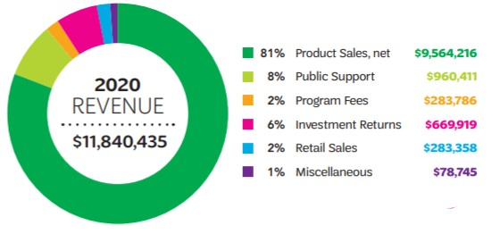

Slide 8
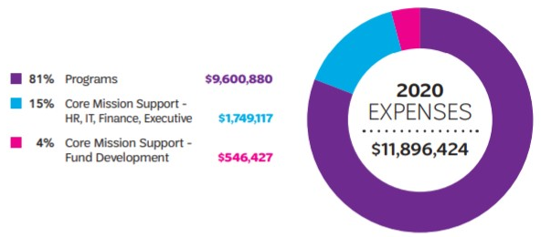

Slide 9
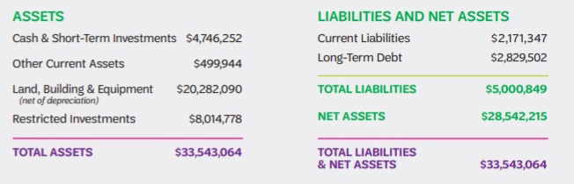
September 30, 2020

Slide 10
FINANCIAL REPORT ANALYSIS
Financial condition is good. 2019-2020 results impacted by COVID-19:
  Program reductions including resident camp
  Reduced operating expenses
  Positive investment performance
  Forgivable government loan programs
2020-2021 operations will incur some losses due to COVID-19 impact:
  Programs have been eliminated or scaled back
  Personnel and other operating expenses have been reduced
  Government assistance programs are offsetting reduced revenue
Financial reserves, budget reductions, and government assistance will sustain GSNEO in good financial health through the 2022 product sale program.
Audited financial statements and Federal Form 990 online at gsneo.org
Notes:
Kate: I will now turn the meeting over to Sandy Rapp for the Audit and Risk Management Committee Report.

Slide 11
Audit/Risk Management Committee
Sandra Rapp, Committee Chair

Slide 12
Audit & Risk Management
Auditor issued opinions stating:
  The financial statements were fairly presented
  There were no internal control weaknesses
Auditors had no suggestions for improvements
Insurance coverage is sufficient for identified risks, however all coverage for pandemics has been eliminated
Computer network infrastructure, data, programs, and processes are well-protected
Police reports were filed in two instances of troop leader financial misconduct and are being investigated
Notes:
Sandy: When completed, please turn the meeting over to Allison Baker for the Community Engagement Committee Report.

Slide 13
Community Engagement Committee
Allison Baker
&
Laura Schultz, JD, Co-Chairs
Notes:
Good morning, I am Allison Baker, and I am Co-Chair of the Community Engagement Committee. I’d like to introduce my Co-Chair Laura Schultz

Slide 14
Community Engagement Committee Purpose
To learn about GSNEO and how we’re building girls of courage, confidence, and character, who make the world a better place
To serve as a community ambassador and advocate
To suggest and connect collaborator partners and funders
To advise and lend expertise to new and existing initiatives as well as create new opportunities
Notes:
Laura: This past year we reimagined the Fund Development Committee to become the Community Engagement Committee. This changes reflects a broader scope of our purpose and it is also reflected in the expertise of our committee members. We all serve as ambassadors and advocates for GSNEO in the Northeast Ohio community. Our purpose is to suggest and connect partners and funders for GSNEO and to lend our expertise to new and existing initiatives.

Slide 15
Community Engagement Committee Charge
Identifying outreach and engagement opportunities throughout the 18 counties GSNEO serves.
Examples of opportunities for volunteer engagement could be in the area of Fund Development, Branding, Social Media, Marketing, Advertising, Consulting, Financial Management, Advocacy, Technology Assistance, and Diversity, Equity, and Inclusion, in essence, any expertise or connection that brings resources or saves expenses for GSNEO.
The committee serves as an intermediary between the community and GSNEO Board of Directors to cultivate meaningful relationships with members of our communities, nonprofits, corporations, foundations and individuals.
Notes:
Allison: Our committee’s charge is to identify outreach and engagement opportunities through the 18 counites that GSNEO serves. We serve for an intermediary between the community and the GSNEO Board of Directors to cultivate meaningful relationships We are looking for engagement opportunities in fund development, branding, social media, marketing, advertising, consulting, financial management, advocacy, technology & DEI.
We have 23 committee members who represent a variety of backgrounds, but we are always looking for new members

Slide 16
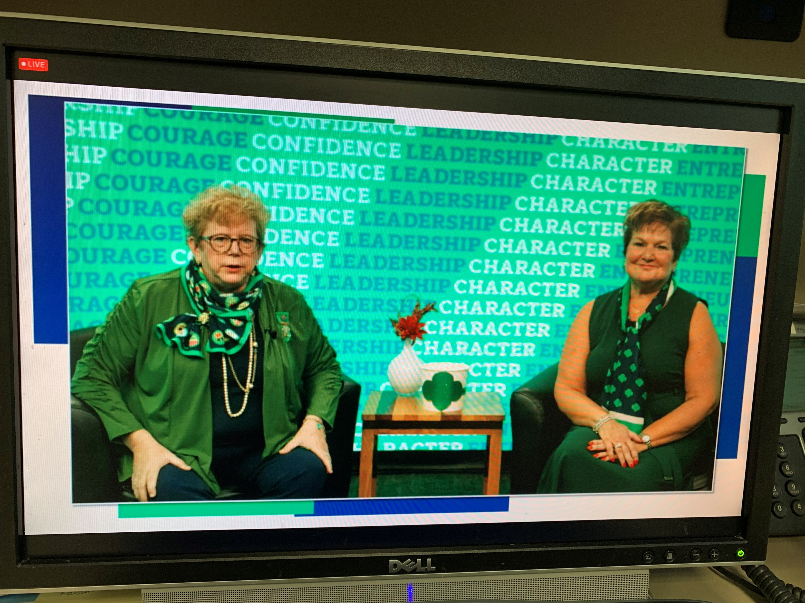
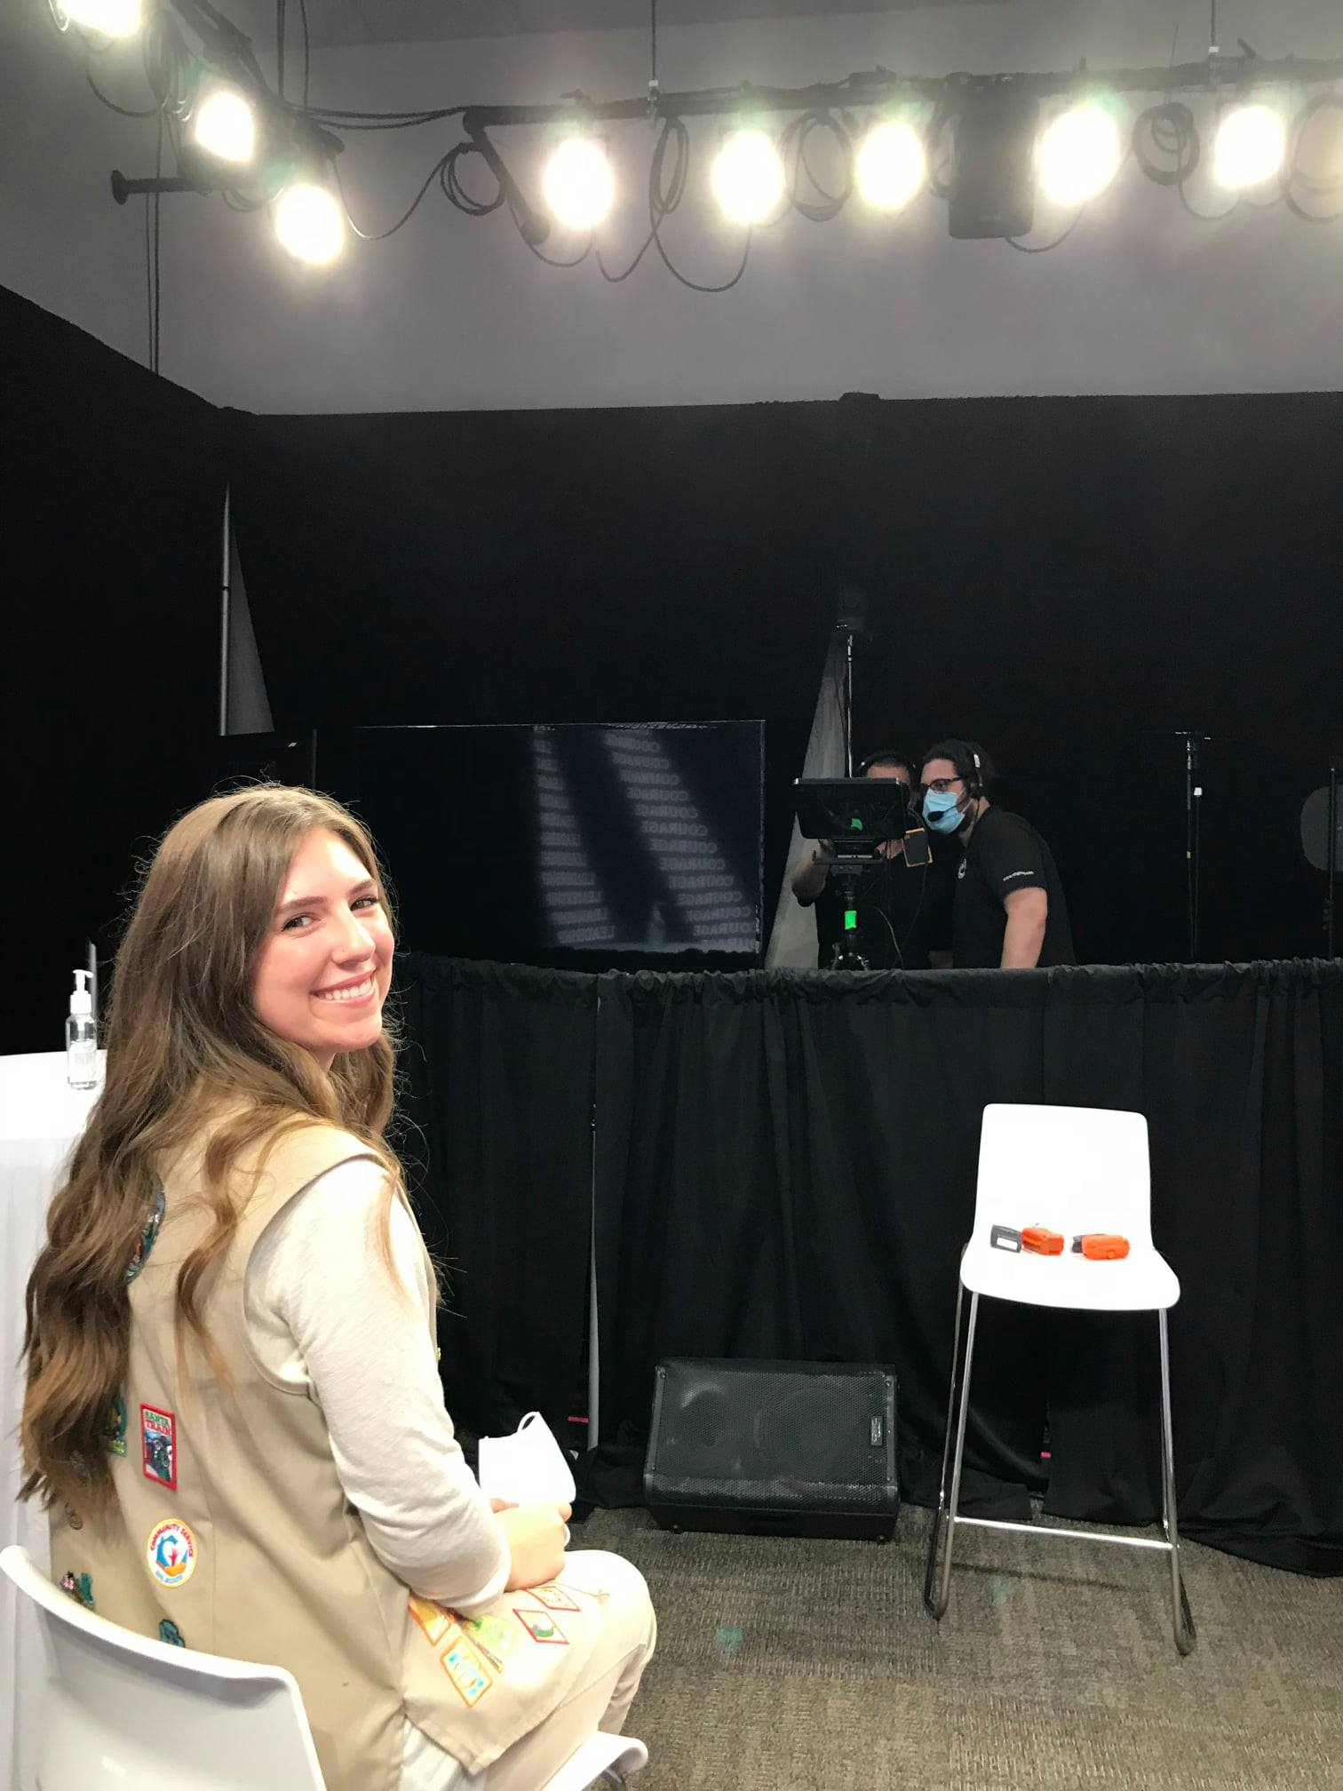
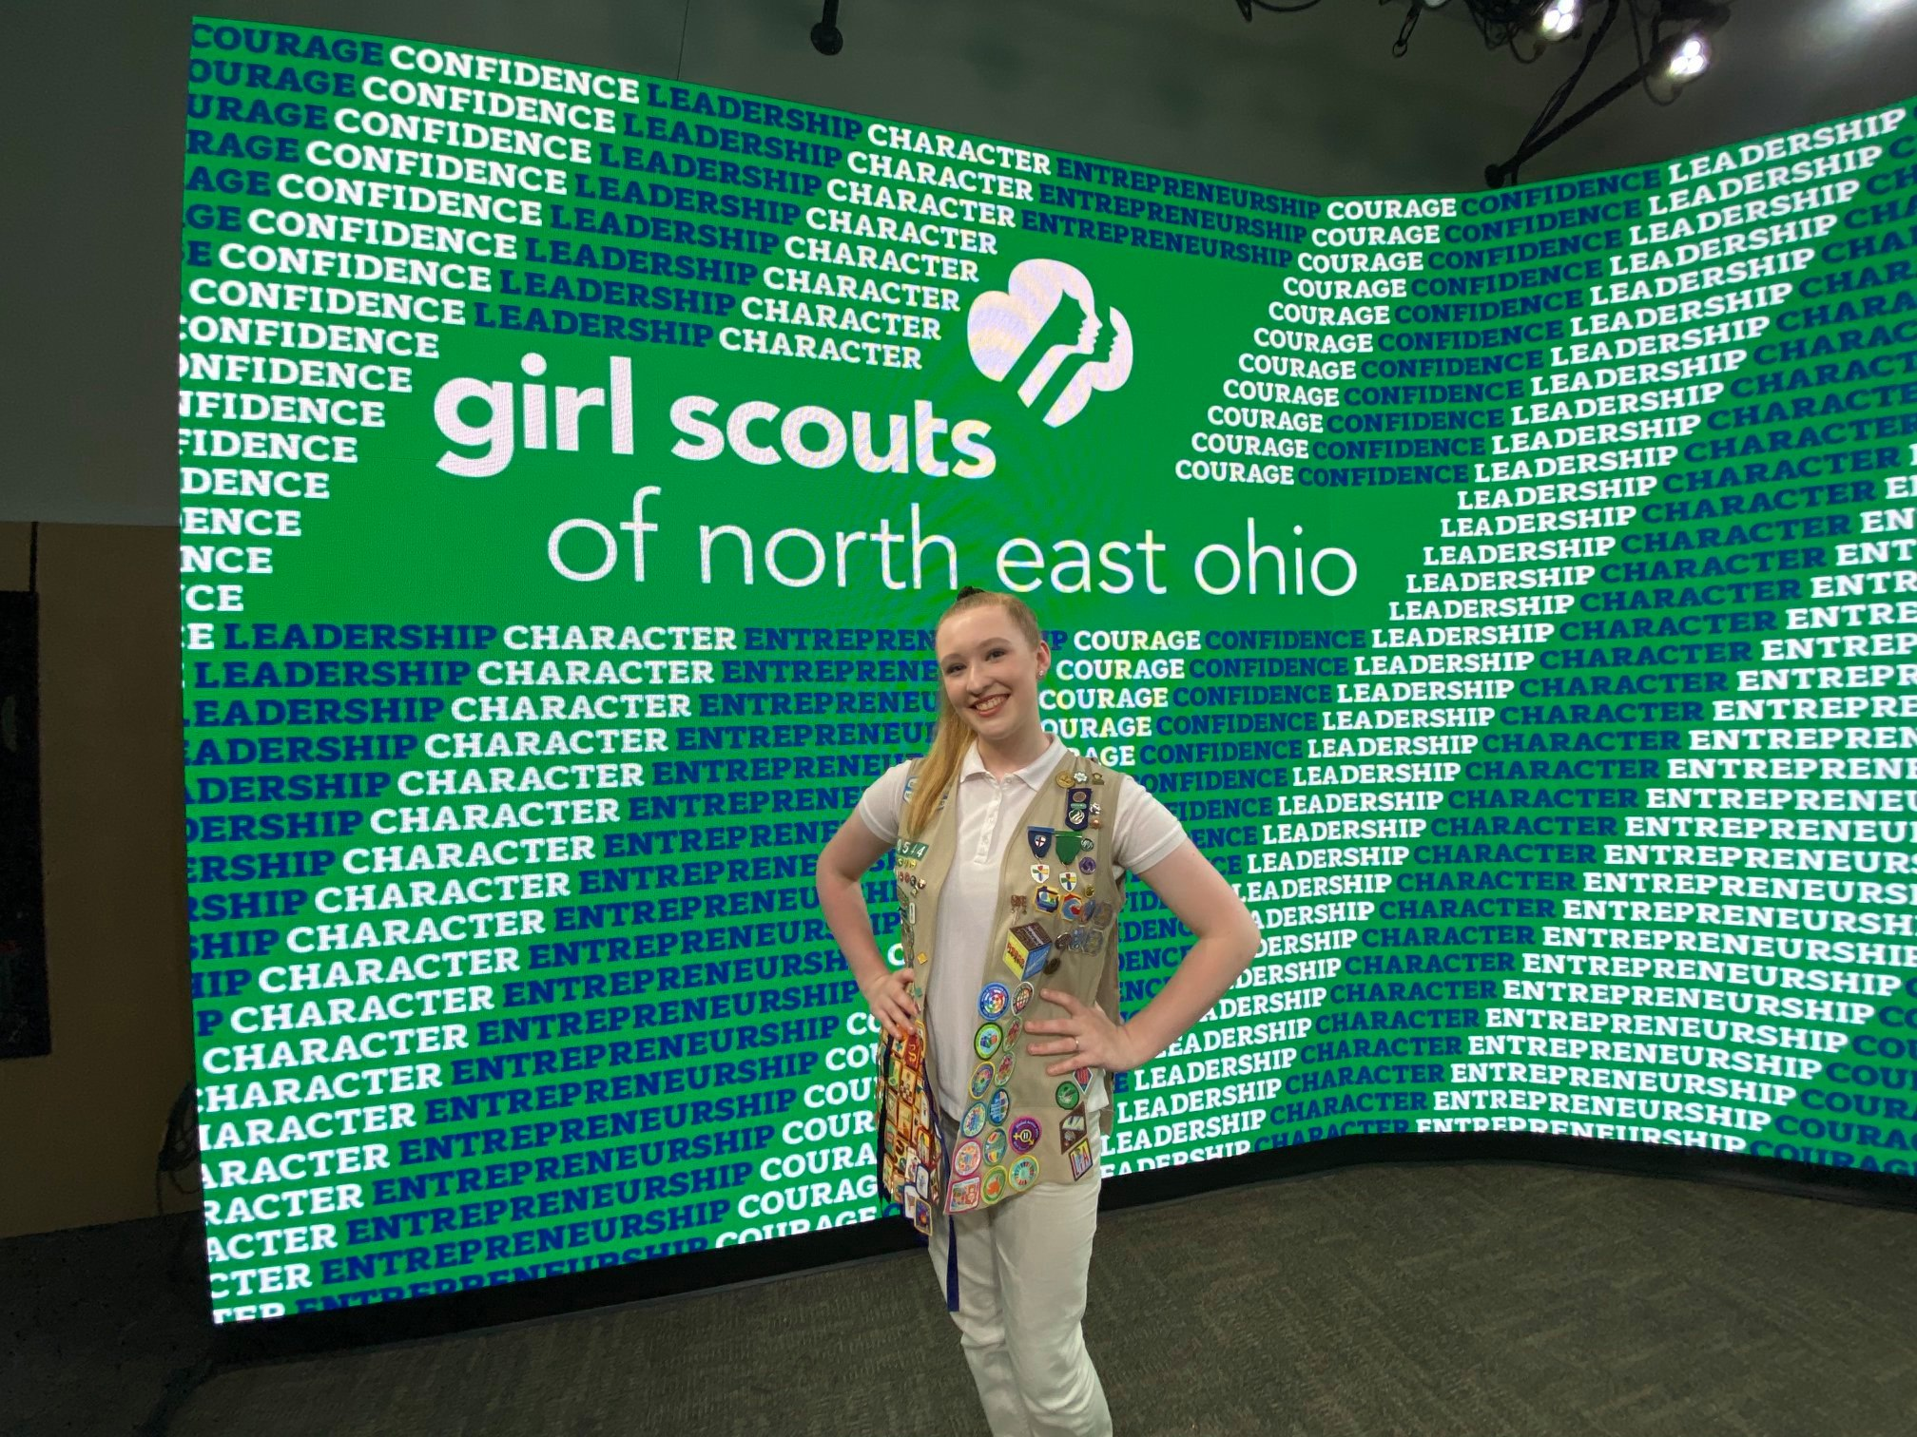
2020 Women of Distinction Awards
Our first Women of Distinction Virtual Event netted over $58,000
The Facebook live event had 844 views and the Livestream had 412 views
Thank you to Event Chair Kathy Moock for your leadership in making our first virtual event a success!
Notes:
Laura: On September 22, 2020 we held our first Virtual Women of Distinction event. Our event netted over $58,000. Our Livestream had 412 views and the Facebook live event had 844 views, and we were thrilled with the online engagement. A huge thank you to Event Chair Kathy Moock for making this event such a success!

Slide 17

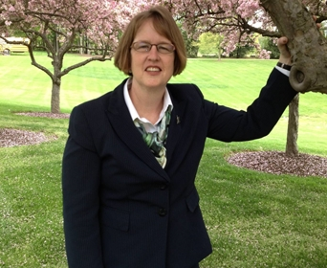

2021 10th Anniversary
Women of Distinction Awards Virtual Event
SAVE THE DATE!
May 7, 2021
3:00pm
Register online : https://e.givesmart.com/events/kfe/
Sandee Reid
VP Corporate Communications, Davey Tree
Event Chair
Sara Shookman
Anchor, wkyc studios
Emcee
Notes:
Allison: Please save the date of May 7th for our 10th anniversary Women of Distinction Awards event. Sandee Reid, VP of Corporate Communications at Davey Tree, is our Event chair. She is also a 2020 Woman of Distinction and GSNEO Board Development and STEM Committee member. Sara Shookman, Anchor at WKYC, and also a 2020 Woman of Distinction will be our Emcee. The event will be virtual and tickets are free, but we do have a special promotion for donors who contribute $100 or more to the event. Those donors will receive a limited-edition Women of Distinction scarf. If you would like more information about how to support the event, go to the GSNEO website.

Slide 18
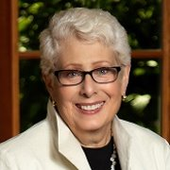
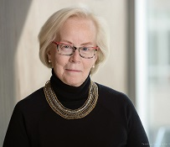
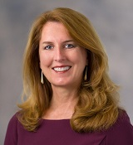
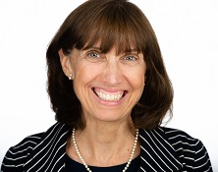
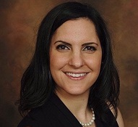
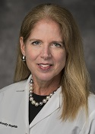
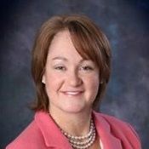
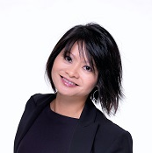
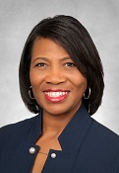
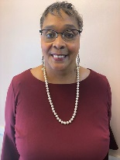
2021 Women of Distinction Honorees
2021 Women of Distinction
​ | M. Ruth Coleman​ Principal – ValTrans Health​ Founder – Health Design Plus​ ​ | ​ | Jan Morrison​ Founder and CEO – TIES​ | ​ | Sandy Rapp​ SVP, CIO – Travel Centers of America​
​ | Marianne Crosley​ President and CEO – Cleveland Leadership Center​ | ​ | Tania Nemer​ Community Outreach Prosecutor – Summit County Prosecutor's Office​ | ​ | Vivian von Gruenigen, M.D., M.S., Prof.​ Gynecologic Oncologist – Northeast Ohio Medical University​
​ | Elizabeth Engels​ President – Acer Consulting​ ​ | ​ | QuynhGiao Nguyen, Ph.D.​ Program Element Manager; NASA's Game Changing Development Program – NASA​ ​​ | ​ | Lorna Wisham​ VP, Corporate Affairs & Community Involvement and President, FirstEnergy Foundation – FirstEnergy​
​ | ​ | ​ | Tracy A. Oliver​ Director Media and Local Affairs – Dominion Energy Ohio​ | ​ | ​
Notes:
Laura: We have an amazing group of Women of Distinction this year. Please join us on May 7th when we celebrate our 2021 honorees!

Slide 19
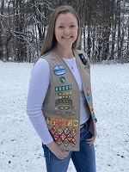
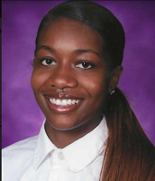
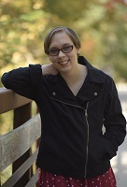

2021 Women of Distinction Honorees
2021 Leaders of Tomorrow
Scholarship Recipients
2021 Advancing Women
Award Honoree
Hailey Edie
Carrollton High School
Nia Guess
Cornerstone Christian
Academy
Halle Preneta
Kenston High School
Nestlé USA
Notes:
Laura: We also have 3 outstanding Girl Scouts who are being recognized as our Leaders of Tomorrow. Nestle will be honored as our 2021 Advancing Women Honoree for their strong commitment to developing female leaders in the workplace.

Slide 20
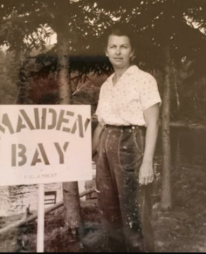

Community Engagement Highlights
Raised over $100K to support Social Justice Seeker program
Received a $10,000 bequest from the estate of Elsie Sickafoose to support financial aid for girls
Notes:
Allison: This past year has been full of challenges but we also have successes to share with you. We have raised over $100,000 to initiate our new Social Justice Seeker program to combat systemic racism and promote social justice in our communities, youll hear more about this program later today. We also received a $10,000 bequest from the estate of Elsie Sickafoose to support financial aid for our girls. Interesting to note although Elsie was not a Girl Scout, she want to support our mission particularly our outdoor adventures.

Slide 21
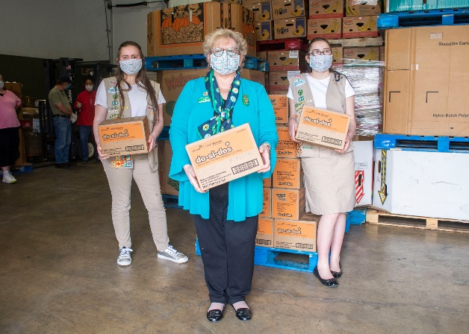
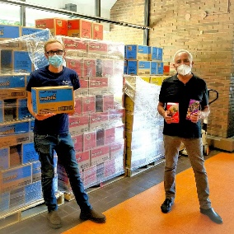
Community Engagement Highlights, continued
Raised over $62,000 for the Cookie Relief Fund to provide relief to troops with cookie surplus across the council
Provided cookie donations in honor of our most generous partners to the Akron-Canton Foodbank, Second Harvest Foodbank, Cleveland Foodbank, Hunger Network of Cleveland, May Dugan Center, Akron Metropolitan Housing Authority, Akron Children’s Hospital and Rainbow Babies & Children’s Hospital.
Notes:
Laura: In response to the challenges we faced with last year’s Cookie Program we created the Cookie Relief Fund which provided over $62,000 to provide relief to troops. With the surplus of cookies we had at the end of the season we were able to provide donations of cookies in honor of some of our most generous partners to an array of organizations serving those in need, including food banks, housing authorities, and healthcare organizations. And now, I would like to turn the meeting over to Cindy Skelton-Becker for the Properties Committee Report.

Slide 22
Properties
Cindy Skelton-Becker, Committee Chair
Notes:
Cindy: In spite of Covid, we were still able to complete many critical maintenance projects to protect our structures and enhance the beauty of our camps.

Slide 23
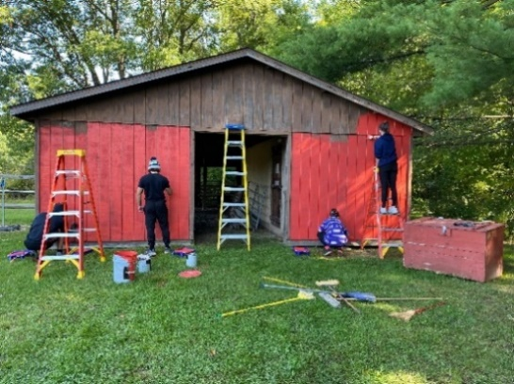
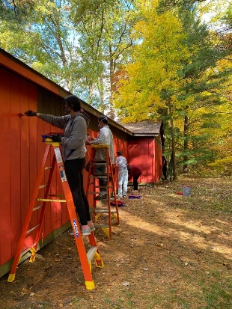
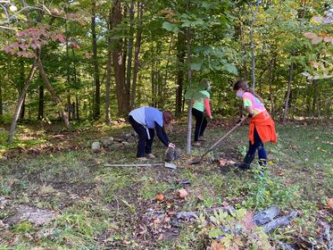
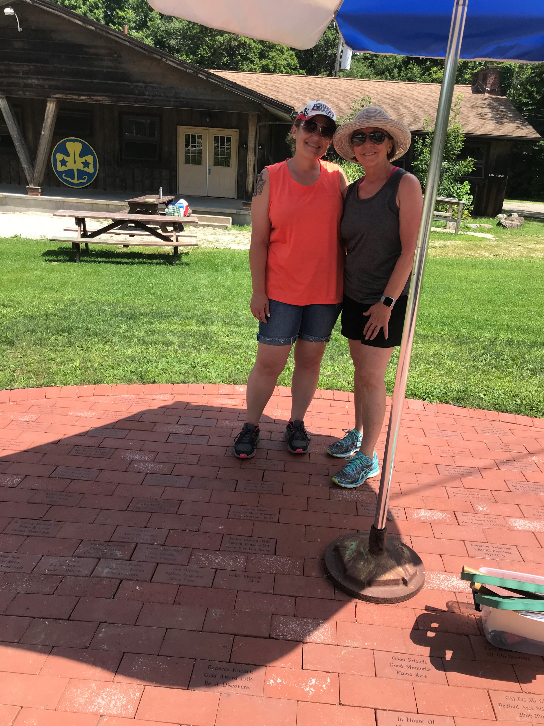
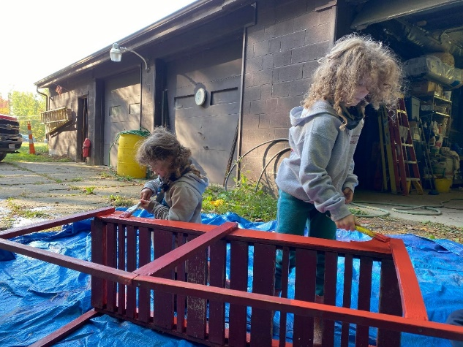
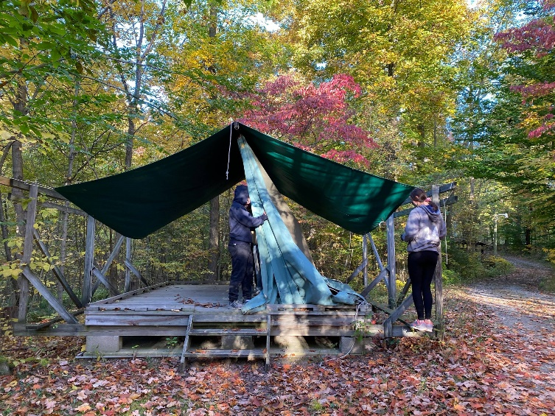
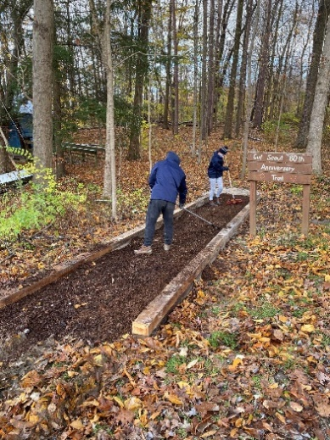
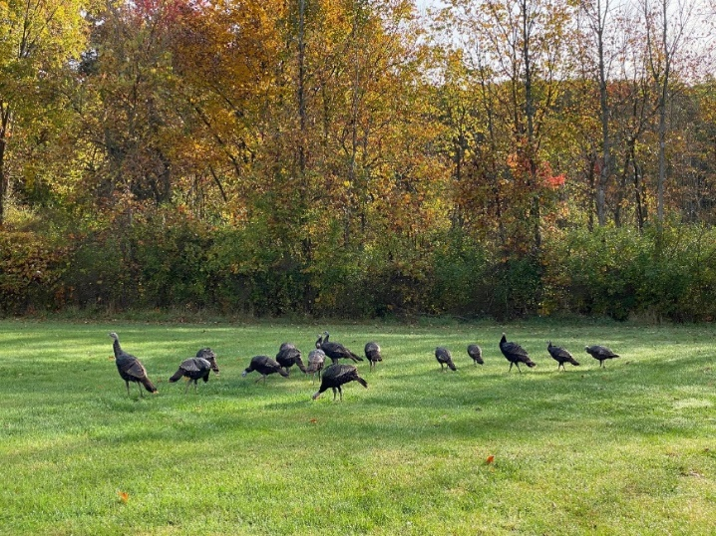
Camp Ledgewood
Notes:
Speaker: Cindy
Here are a few highlights from Camp Ledgewood.
Beginning on the far left, you see volunteers Lisa and Becky reorganizing the bricks in the Legacy Plaza from Camp Lejnar. Moving to the right you see 2 pictures of two of our hard-working trail volunteers. On the top right, there are student from Hudson High School repainting the red barn. Below that is a family group painting a small ceremony bridge and volunteers taking down tents for winter storage. And last but not least, a picture of a flock of turkeys – a popular Camp Ledgewood site.

Slide 24
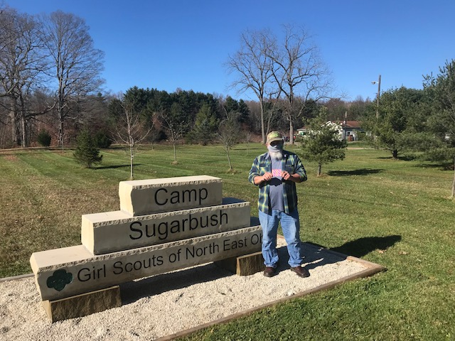
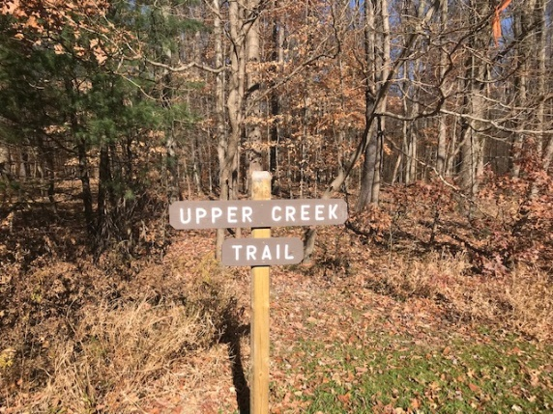
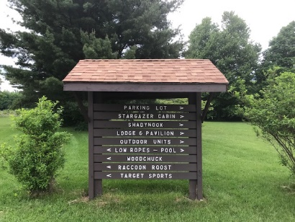
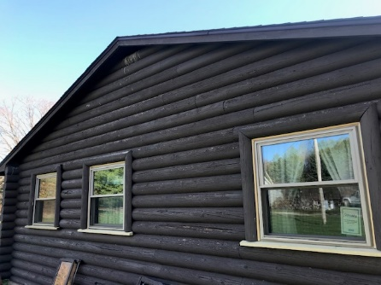
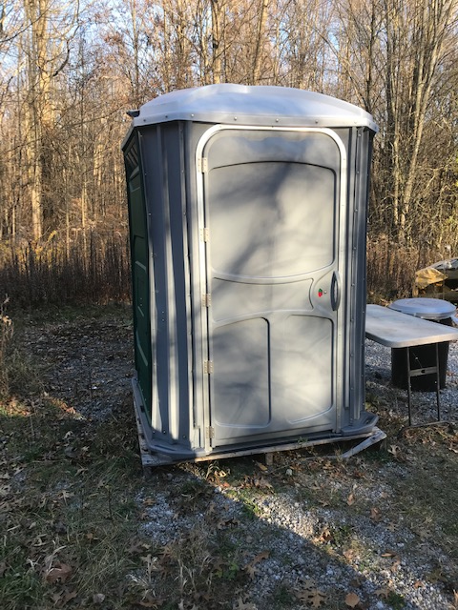
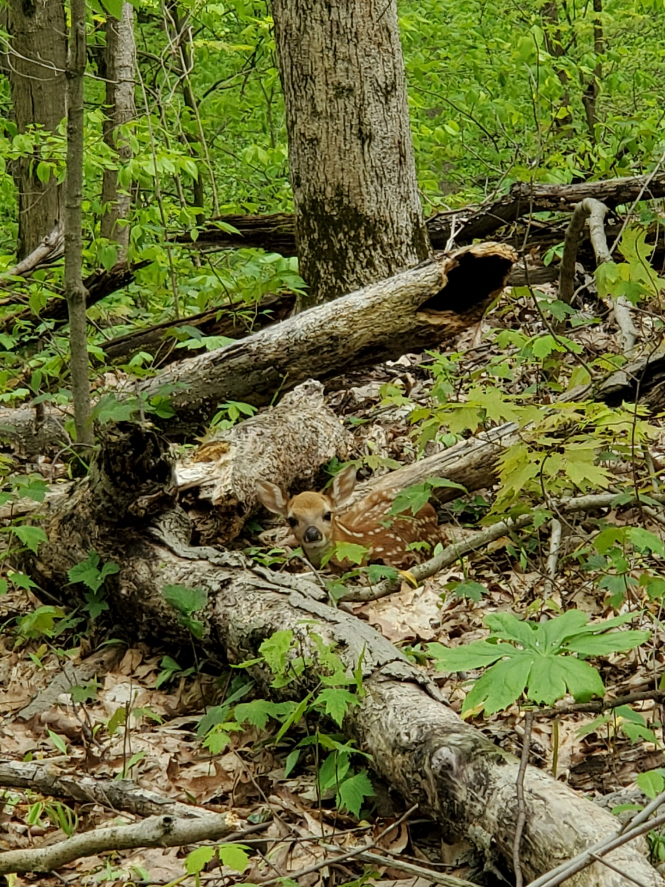
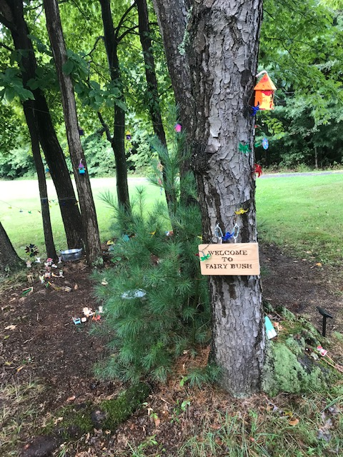
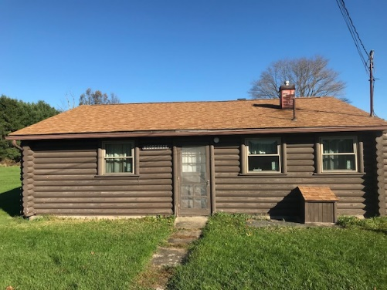
Camp Sugarbush
Notes:
Speaker: Cindy
On the far left is a Portable latrine for Target Sports area. Across the top are pictures of the new signage at camo including a new front entrance sign.
On the far right, Wood Chuck cabin received new windows and screens.
A Fairy Bush World was established and in the middle on the bottom is a picture of some of our hidden wild life – a fawn in woods.

Slide 25
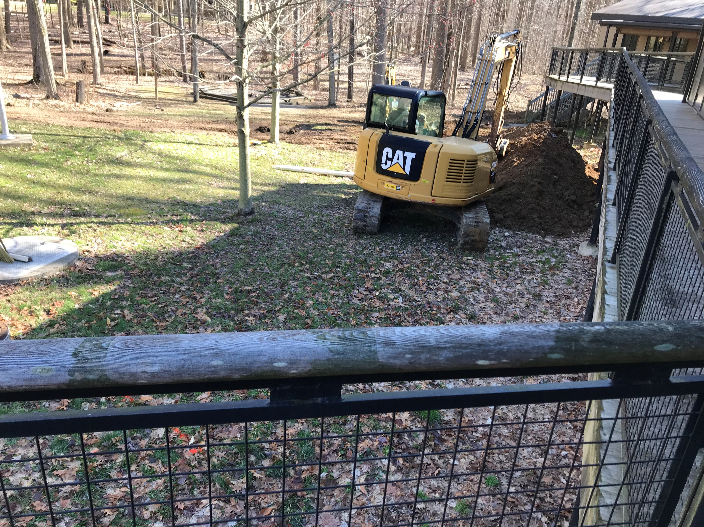
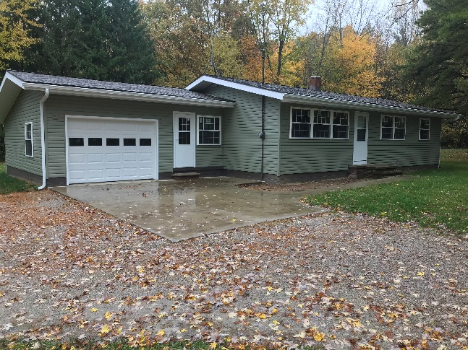
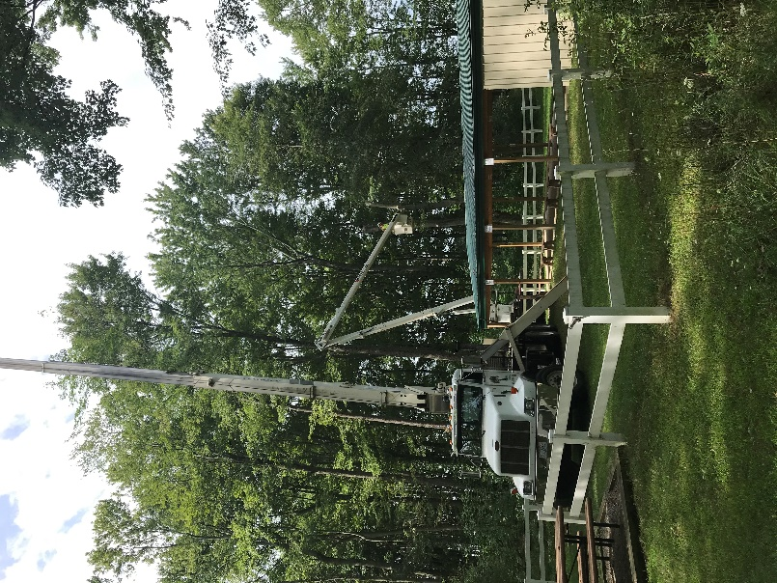
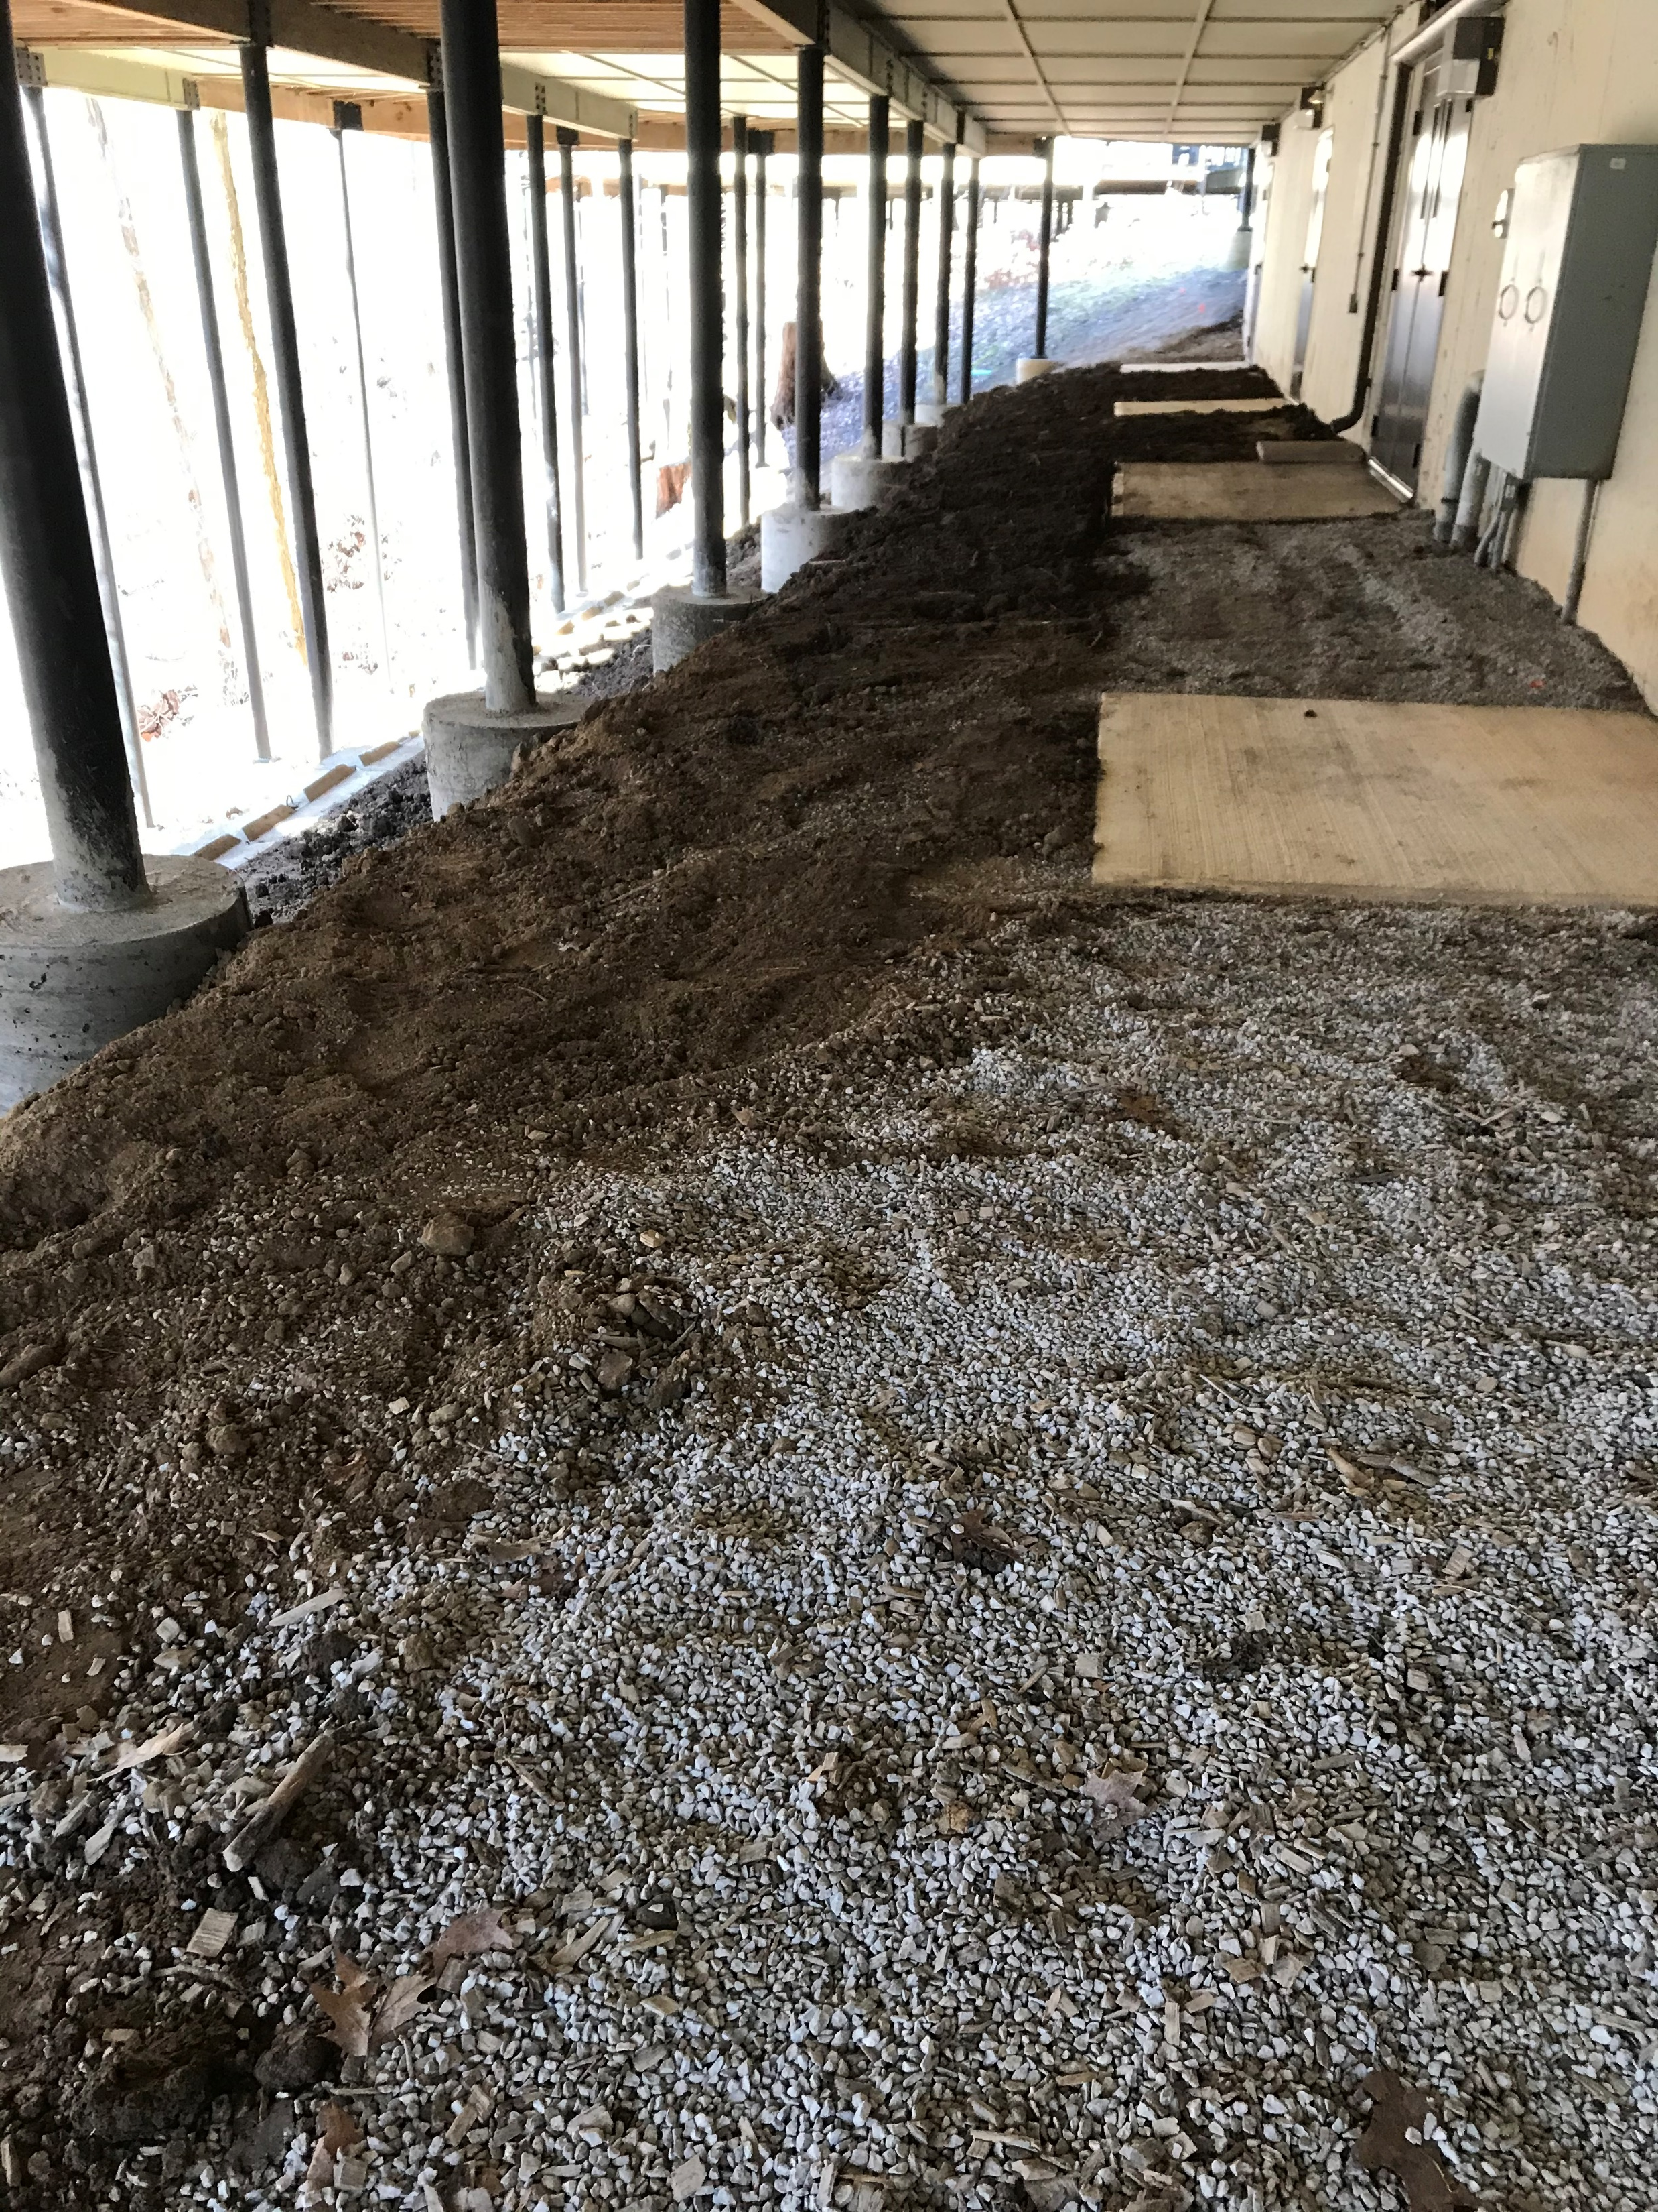
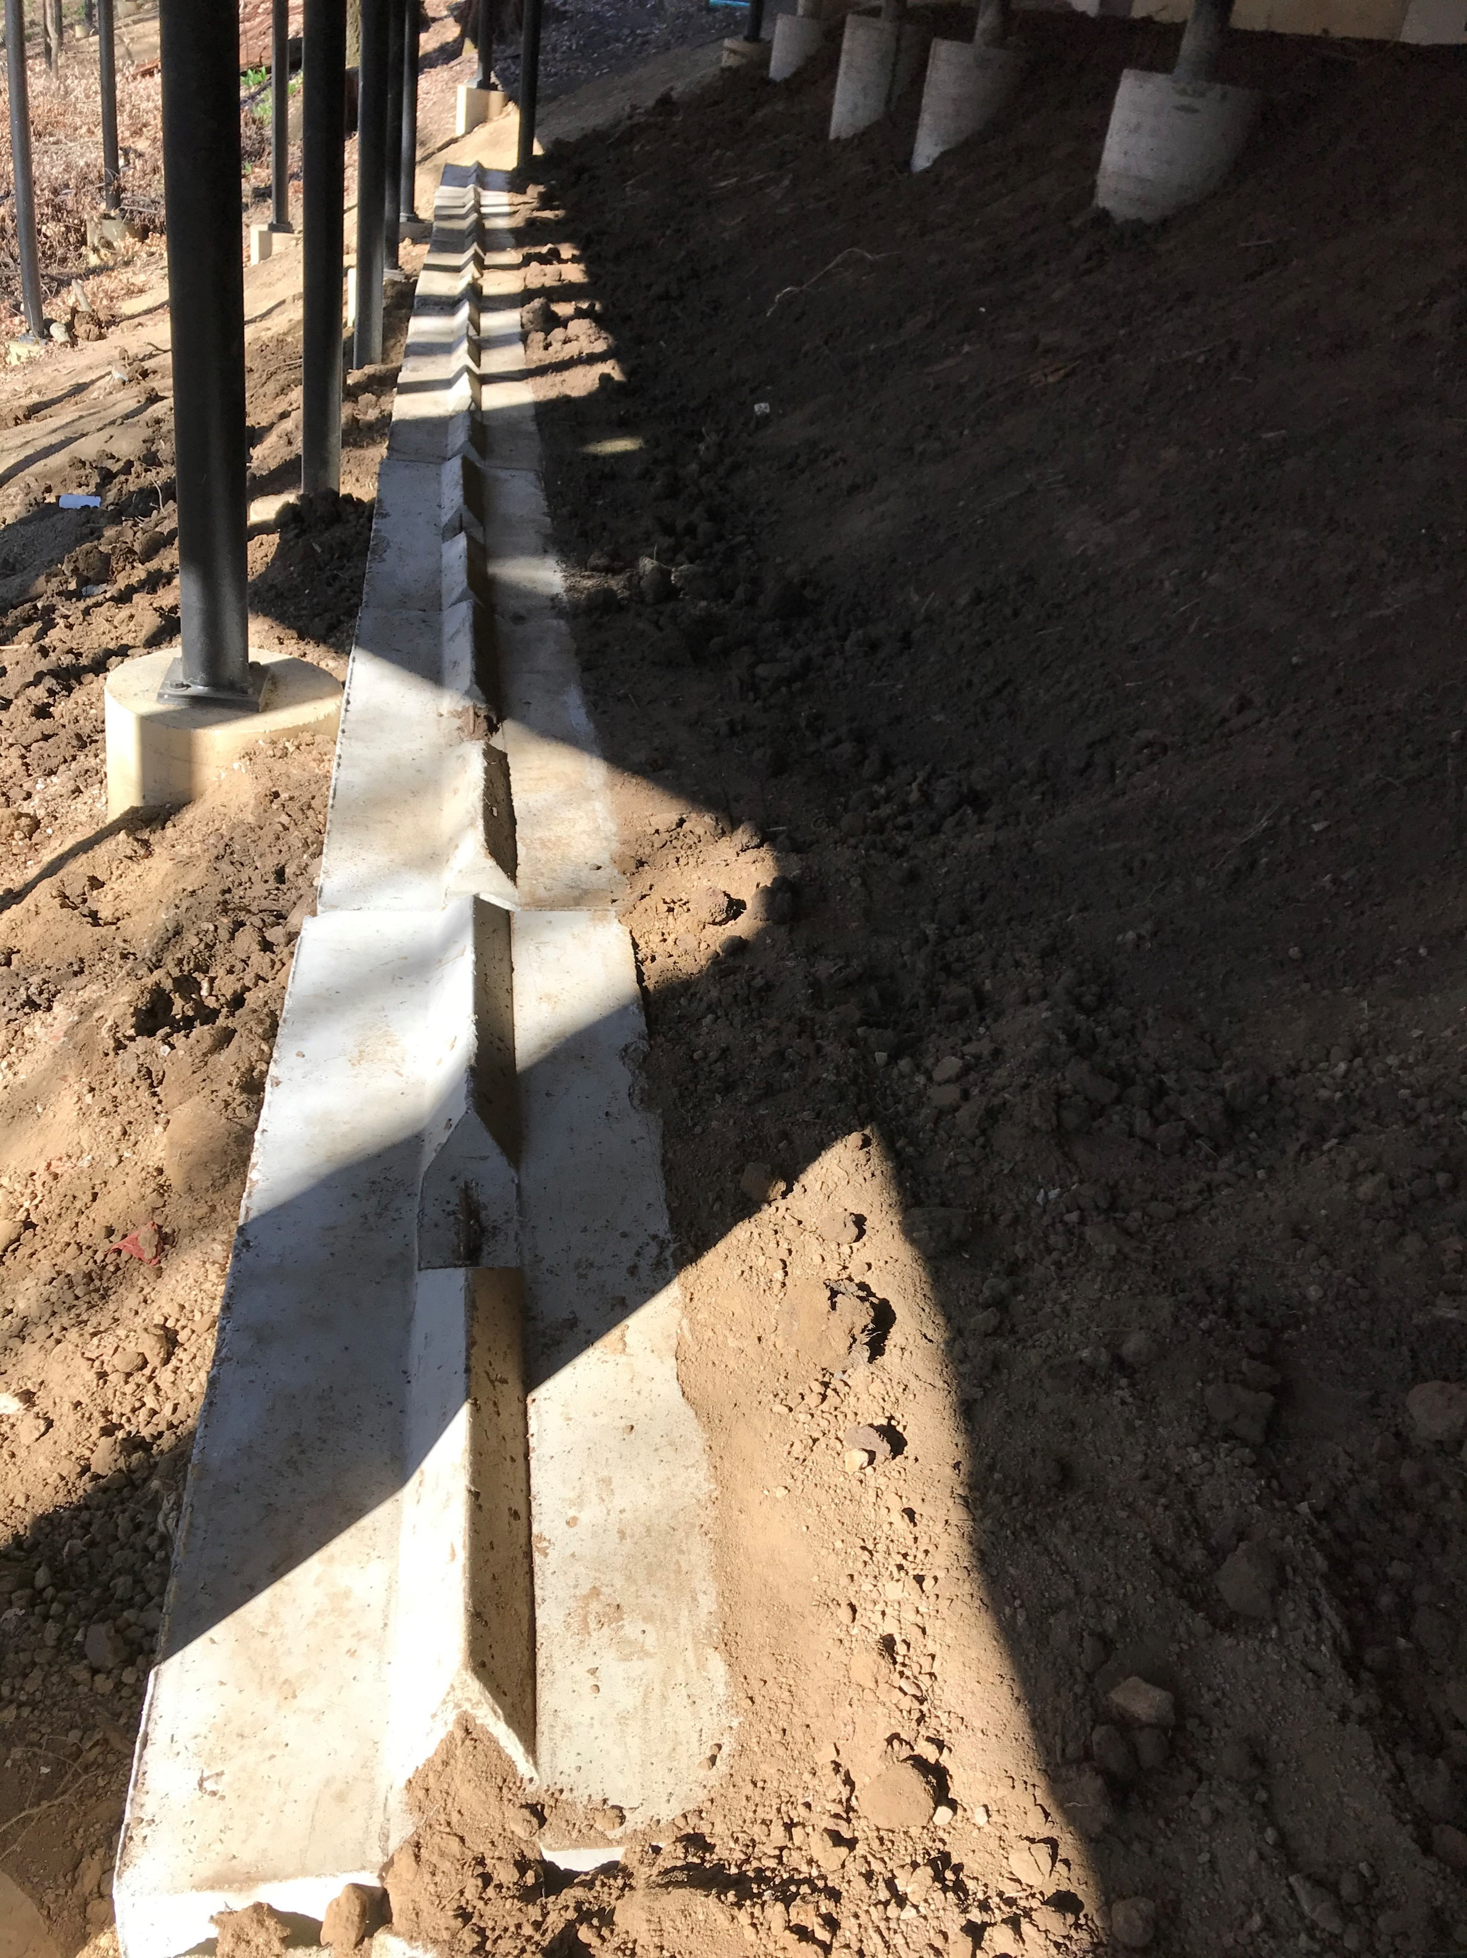
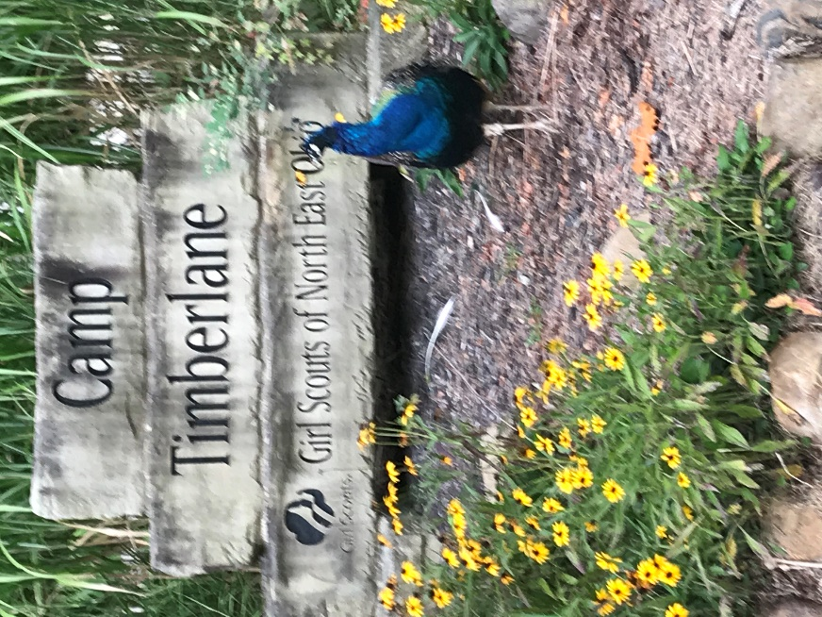
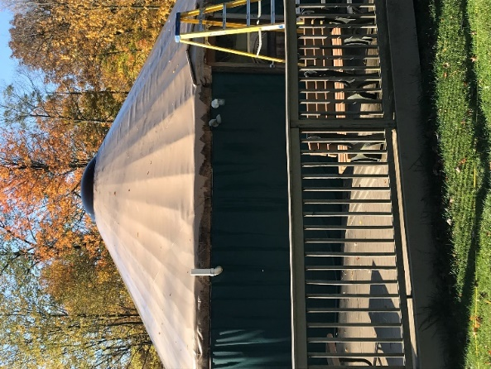
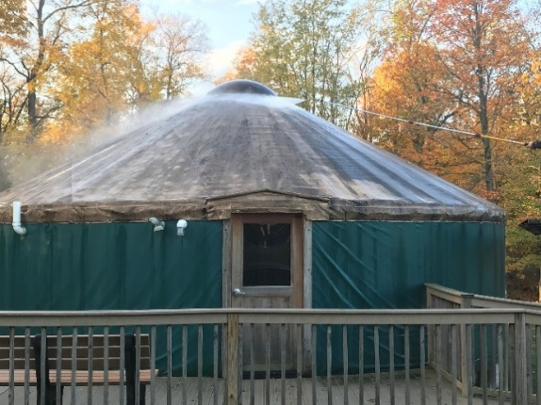
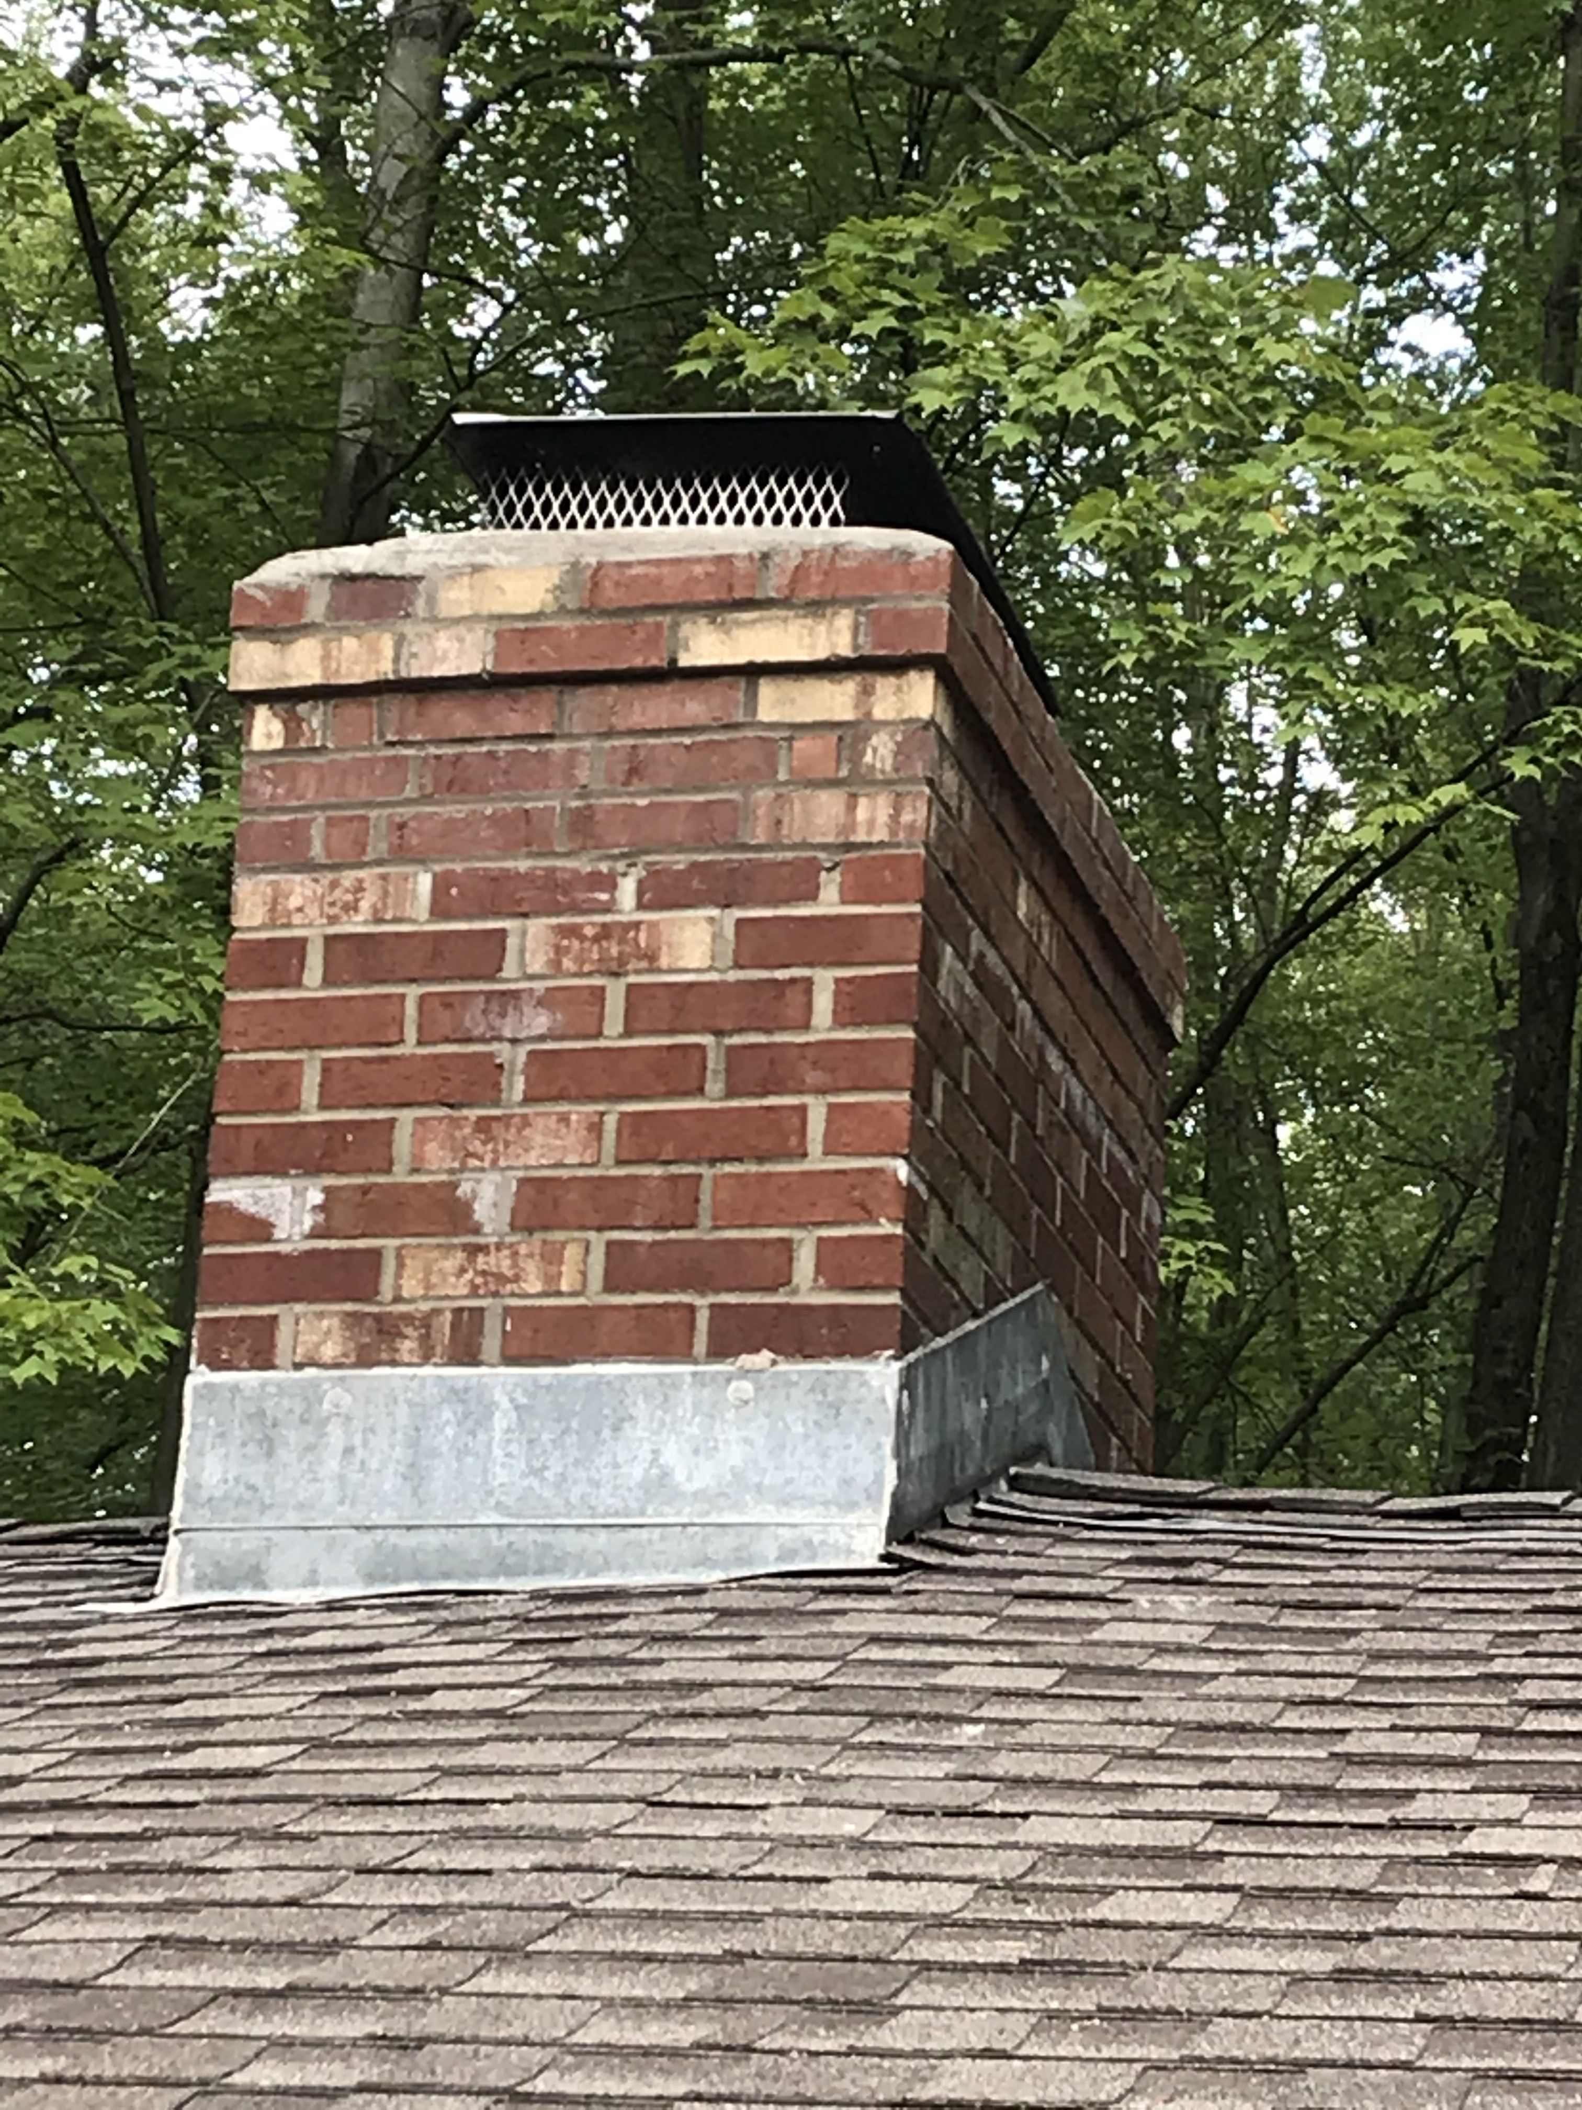
Camp Timberlane
Notes:
Speaker: Cindy
At Camp Timberlane, on the far left is a picture of some of the tree removal we do to ensure everyone stays safe. Next to it on the right are three pictures of a project at Tall Timbers which drained water away from the building preventing foundation damage. On the top right-hand corner, a picture of new windows and foundation at the Camp Coach house
On the bottom left is a picture Yurt before and after cleaning.
We were able do maintenance and repair on several cabin chimneys including Oak cliff. On the bottom right-hand corner is our neighborhood Peacock posing by the entrance sign. And now, I will turn the meeting over to Matt Inks for the Strategic Initiatives Report.

Slide 26
Strategy Alignment & Special Projects Committee
Matt Inks, Committee Chair

Slide 27
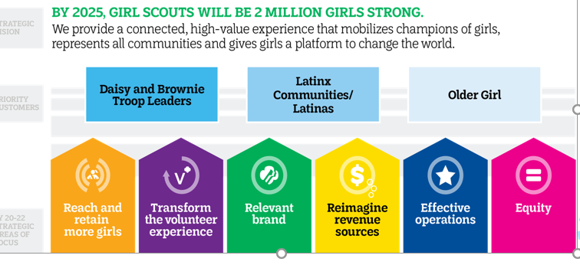
FY 21-23 Movement Strategy Overview

Slide 28





Our GSNEO Strategic Cycle 2021-2023
Prep Step
Review Current Strategy Position for Readiness & Create Teams
Step 1
Step 2
Step 3
Step 4
Environmental Scan / Current State Analysis
Identify
Gaps
&
Initiatives
Finalize & Prioritize Initiatives
Finalize Roadmap Execute & Evaluate
1/1/20-12/31/20
1/1/21-4/29/21
4/30/21-9/30/23
Strategic Planning &
Initiative
Committee
Board Members, Council Leadership, Staff, Members, etc.
Sub-Committee Kick-Off 2/3; Sharing deliverables with Committee, Board, & Council for Feedback 3/22, 3/24, 4/10
Finalize Roadmap & Execute

Slide 29
Sub-Committee Process Executive Summary
Our strategic process officially kicked off with our sub-committees on 2/3
The committees focused on the six strategic priorities, and consisted of 14 volunteers, 7 board members, and 14 staff members
They met over 25+ meetings, and spent many hours researching threats/competitors, weaknesses, strengths, and opportunities
Culminating in full current state and gap analysis that led to focused vision statements, and 30 strategic initiatives focused on each of our priorities with two elevated areas of focus around STEM & Equity

Slide 30
Sub-Committee Team Members
2021-2023 Sub-Committee | Sub-Committee Team Members
Reach and Retain More Girls | Staff Lead- Emily Fein Staff - Lindsey Harris, Fallon Pulley Board- Ellen Stephens Board - Kristina Wilson | Volunteer - Me’lani Labat Joseph Volunteer - Heather Renz
Transform the Volunteer Experience | Staff Lead- Emily Fein Staff- Kim Klima, Staff - Julie Lampe Board- Christine Young | Volunteer - Kenya Guess Volunteer - Missy Schreiner
Relevant Brand | Staff Lead- Jane Christyson Staff- Breanna Ganuelas Board- Ellen Stephens Board - Kristina Wilson | Volunteer - Greta Foster Volunteer - Una Lauricia Volunteer - Vivian von Gruenigen Volunteer - Jessica McGrath

Slide 31
Sub-Committee Team Members
2021-2023 Sub-Committee | Sub-Committee Team Members
Reimagine Revenue Sources | Staff Lead- John Graves Staff- Julie Weagraff Staff - Sue Majzun Board- Judy Matsko Board - Chris Venditti | Volunteer- Ann Manby Volunteer - Gretchen Harnick
Effective Operations | Staff Lead- John Graves Staff- Lizbeth Kohler Staff - Jane Christyson (Property Review) Board- Matt Inks Board - Kate Asbeck | Volunteer - Stephen Johnson Volunteer - Christina Sauer
Equity | Staff Lead- Jane Christyson Staff- Lisa Maida Board- Christine Young | Volunteer- Angela Brake Volunteer - Ebony Yeboah Amankwah

Slide 32
2021-2023 Strategic Priorities | 2021 – 2023 GSNEO Vision Statements
Reach and Retain More Girls | GSNEO’s promise to girls and their families is to provide all girls in the council’s footprint the foundational Girl Experience. By leveraging partnerships and focusing on engaging marginalized communities, we will offer varied, well-rounded experiences through supportive adult relationships in a girl-led, hands-on, shared learning environment.
Transform the Volunteer Experience | GSNEO’s promise to volunteers is to provide a diverse array of volunteer opportunities that are flexible and welcoming; offer the support they need, when they need it, in a way that fits their busy lives; and provide an experience where they feel connected to the power of the mission and thrive in a culture of appreciation.
Relevant Brand | GSNEO is recognized as the go-to organization for championing girls’ ambition from K-12 and creating a talent pipeline for innovation and technology industries in Northeast Ohio. We will fulfill this vision by focusing on the following experiences and communication efforts: Highlighting STEM interest and achievements within local troops as a leading metric compared to other pillars; clarifying and communicating girls’ interests in activities compared to parents’ expectations; and continuing to build relationships with local businesses to be recognized as a pipeline of talent.
Notes:
*2020 survey taken during May 2020 at the beginning of the COVID-19 pandemic and as cookie season was wrapping up. Sample size and results were lower than our typical results.

Slide 33
2021-2023 Strategic Priorities | 2021 – 2023 GSNEO Vision Statements
Reimagine Revenue Sources | GSNEO will build an organization-wide culture of philanthropy with strong, diverse revenue streams and revenue streams less dependent on product sales. To accomplish this, we will increase visibility of GSNEO in the philanthropic community; grow individual giving; increase the pipeline of planned gifts; execute capital campaigns on an ongoing basis; grow property rentals by outside groups substantially and expand program revenue.
Effective Operations | GSNEO will maximize its use of resources to provide the most effective organization by: Continuing to refine our business processes and develop a more efficient and effective staff structure; improve the infrastructure to efficiently support Movement goals; maintain or reduce management costs as a percentage of total costs and plan annual capital improvements budget, and annual debt repayments so that they may be funded without reducing operating reserves.
Equity | GSNEO’s commitment to diversity, equity, inclusion, and access is the shared responsibility of our members. We are committed to provide an inclusive environment for all girls regardless of their socio-economic status, color of their skin, or other factors that contribute to inequity in the world today. We envision an organization where: All girls are free to be themselves; diversity, equity, inclusion, and access drive decision-making and policy creation across our council jurisdiction; diverse board members, staff, and girl and adult members are actively recruited, retained, and supported; and we have collaborative external partnerships to support the needs of our members by creating a safe environment which promotes inclusivity.

Slide 34
Key Next Steps
Solicit any additional feedback from all of you, our board, and sub-committees on our vision statements
Finalize focused initiative plan supporting each of our priorities through 4/30
Execute on strategic initiatives plan through end of 2023

Slide 35
Questions/Feedback
For more detailed information on the Strategic Initiatives process please go to https://www.gsneo.org/strategy

Slide 36
STEM Advisory Committee
Dr. Diana Bilimoria
Chair, STEM Advisory Committee
Notes:
Good morning, I am Diana Bilimoria, Chair of the STEM Advisory Committee

Slide 37
The Need
1M+
THE GENDER GAP
Women—More than 47% of
our workforce comprise less
than 28% of STEM jobs.²
THE DEMAND
1M+ new STEM professionals
in next decade to fill the
job pipeline.¹
Sources: 1.President’s Council of Advisors on Science and Technology, Engage to excel: producing one million additional college graduates with degrees in science, technology, engineering, and mathematics (Executive Office of the President of the United States, 2012).
2. U.S. Department of Commerce. (2011). Women and STEM: A Gender Gap to Innovation
Notes:
Women and girls are underrepresented across all levels of the STEM pipeline but there are huge opportunities.
Between 1990 and 2016, occupations in STEM grew 79%
The national average wage for all STEM occupations is $87,570, nearly double that of non-STEM occupations of $45,700
Women filled 47 percent of all U.S. jobs, but hold only 28 percent of STEM jobs.
We say Those are jobs for a Girl Scout.
It’s time to stop squandering the potential of half of the population and get them ready to meet very important emerging needs of the North East Ohio workforce.

Slide 38


NEW STEM Badges
Automotive Engineering badges (grades K–5)​
​Girls learn about designing, engineering, and manufacturing vehicles, as well as the future of mobility. They design their own vehicles, test prototypes, learn about design thinking, create their own assembly line manufacturing process, and more.
STEM Career Exploration badges (grades 2–8)​
Girls explore their career interests and connect them to STEM fields—particularly computer science, nature/environmental science, engineering, design, health, and agriculture—that can help them address the pressing issues of our time and change the world.​
Notes:
In 2020 GSUSA released 12 new STEM badges.
In the Automotive Engineering badges, Girls learn about designing, engineering, and manufacturing vehicles, as well as the future of mobility. They design their own vehicles, test prototypes, learn about design thinking, create their own assembly line manufacturing process, and more.
In the STEM Career Exploration badges, girls explore their career interests and connect them to STEM fields—particularly computer science, nature/environmental science, engineering, design, health, and agriculture—that can help them address the pressing issues of our time and change the world.​
Additional badges for older girls as well as Math in Nature Badges are expected to be released in the summer.
Locally, our Girl Scouts earned over 15,932 STEM badges in the 2020 membership year!!

Slide 39

STEM Advisory Committee Highlights
Increased our STEM partners to 80 members, a 25% increase from last year
STEM Committee meetings were hosted by GSNEO virtually this year
Committee members have:
  Helped secure funding for STEM programming
  Identified and become program partners
  Provided STEM expertise for program development and implementation
Notes:
This has been an amazing year for our committee. We’ve had 3 virtual meetings this year.
We now have 80 committee members, a 25% increase from last year.
Our Committee members have provided support to GSNEO by securing funding for STEM programming, becoming program partner or identifying program partners for GSNEO, and provided expertise for program development and implementation.
Let’s take a look at a few partner highlights.

Slide 40








Partner Highlights
Notes:
Here’s a sample of local programs supported by our partners. We know there are even more opportunities out there and we are committed to make those connections for our girls.
​
Digital Movie Maker (Cadette, grades 6-8) – This tech-savvy training for girls is launched in partnership with the Future Vision Foundation. Girls are able to engage in virtual class sessions to learn about equipment, filming technique, and editing and make their own documentary. ​
​
Sea Perch - Funded by AT&T, girls designed and built remotely operated vehicles (ROVs) and tested them under water in the camp swimming pool!
Code Camp Kidz – We’ve partnered with Code Camp Kidz to offer the Think Like a Programmer Journey. The program is designed for girls who are interested in a full code immersion experience. This fully virtual program lets girls code from home, with the benefit of a live instructor to guide them. ​
​
Girl Power - FirstEnergy Patch Program​
In this program presented in partnership with the FirstEnergy Foundation girls complete a journey or badge work with an electric twist. ​
In the spring of 2020, we moved to virtual delivery and have 3 options for girls to participate: Live Virtual Sessions, On Your Own using recorded sessions, and the Girl Power Box Kit, which includes supplies and instructions.
America Makes –We have been awarded funding for a STEM Coordinator position and have started mapping content to incorporate 3-D printing into our badges.
Programs like: Junior Fabricate Fashion, Daisy Gameboard Design, Brownie Game Maker, and Senior/Ambassador Design in Motion are examples of this work. Much more to come!

Slide 41

Camp Ledgewood STEM Center Update
Notes:
THANK YOU for helping with our letter writing campaign to local legislators in support of our capital request to The State of Ohio!
GSNEO is being awarded a $100,000 capital grant from the State of Ohio; Kent State University is the fiscal agent and our partner
We also received a $50,000 commitment from a family foundation
Project Overview
A $3 million dollar project
Used by Girl Scouts and local students
Inspiring young people to consider STEM careers
Diana introduces Jane for the Operations Report.

Slide 42
Operations Report
Notes:
Jane: Thank you Diana!

Slide 43

2019-2020 Annual Report
The GSNEO Annual Report is available on the GSNEO website in the Council Financial Section or by clicking on this link:
2020 Annual Report (gsneo.org)

Slide 44
National Council Session
Notes:
As you know in October of 2020, GSUSA held its triennial National Council Session.
There were 6 proposals.

Slide 45

All 6 National Council Session Proposals PASSED!
Notes:
Proposals 2, 3,4 and 6 all dealt with various aspects of dues and length of membership and communication of membership changes.
Proposal 1 suggested the establishment of a National Gold Award Scholarship Foundation.
Proposal 5 was an amendment regarding consistency in delegate terms.
All proposal passed.

Slide 46

It May Not Be Orlando…BUT!!!!
Notes:
I was so proud of our National Delegates who spent in excess of 35 hours over one weekend conducting the governance of our national organization.
12 of the 18 National Delegates are GIRLS!
It was so wonderful to see them fulfill the responsibilities with such enthusiasm,

Slide 47
Membership

Slide 48
Membership 2017 - 2020
Notes:
This is a chart of membership numbers for GSNEO for the last 4 membership years.
As you can see the trend is flat or small decline.

Slide 49
Membership Retention 2012-2020
Notes:
Renewals for 2020, began in April 2019, a full year before COVID hit.
On this chart you can see that we had strong retention rates, GSNEO was 3rd in Girl Retention out of all large councils and 16th overall out of 110 councils.

Slide 50
Membership New & Renewed
Notes:
Typically, approximately 70 percent of our membership comes from renewals and about 30% from new members.
Since most renewals were in house before COVID, renewal was not as strongly impact as new girl membership was. Therefore, we can see that for 2020, 76% of our membership came from renewals and about 24% was new members.
Due to the COVID-19 our new girl recruitment went from a what looked to be a strong membership year to a stand still. At this time, MY21 membership is made up of more than 90% renewals.

Slide 51
Total Membership - 2020 Year End Wrap-up
As of 9/30/20 |  | Girls | Adults | Lifetime | Total
Current Membership Year | 2020 YE Goal | 25,350 | 12,410 |  | 37,760
 | 2019 YE | 25,268 | 10,771 | 1,735 | 37,774
 | 2020 E | 23,086 | 9,533 | 1,966 | 34,585
 | Year over year % Change | -8.64% | -11.49% | 13.31% | -8.44%
 | % of Goal | 91.07% | 92.66% |  | 91.59%
Notes:
After starting of the year with a strong Spring renewal campaign and prior to Spring 2020, Membership year 2020 was looking to be another year that GSNEO would exceed our membership goals, just like 2019. Unfortunately, as we have stated earlier, COVID-19 had a major impact on the second half of the membership year which resulted in missing our membership goals for 2020.

Slide 52
Total Membership YTD 2021 – Current Membership Snapshot
As of 4/5/20 |  | Girls | Adults | Lifetime | Total
Current Membership Year | 2021 YE Goal | 19,950 | 11,505 |  | 31,455
 | 2020 YTD | 22,629 | 9,372 | 1,952 | 33,953
 | 2021 YTD | 16,296 | 6,388 | 2,038 | 24,722
 | Year over year % Change | -27.99% | -31.84% | 4.41% | -27.19%
 | % of Goal | 81.68% | 73.32% |  | 78.59%
Notes:
Now let’s look at our membership right now, for this current membership year. We’re just over 6300 girls behind where we were this time last year and 81.5% to goal as of April 5.
We are planning to increase these numbers using the Extended Membership Year option to bring in new members and re-engage lapsed members, who may have taken a pause in Girl Scouts due to COVID.

Slide 53

New Members YTD
Notes:
This chart illustrate how our New membership is doing this year compared to last year. Last year is represented by the purple bar, and the current year by the blue bar.

Slide 54

Renewed Members YTD
Notes:
This chart illustrates how our Returning or Renewed Membership is doing this year compared to last year. Last year is represented by the pink bar, and the current year by the green bar.

Slide 55


Spring Renewal for Membership Year 2022 has begun!
As of April 6:
646 Girls have renewed
285 Adults have renewed
Notes:
Speaking of Renewal, believe it or not, Spring Renewal for Membership Year 2022 began on April 1! In just over a week, we have had over 1000 members renew and reserve their spot for this fall. It is simple to do, just visit gsneo.org/renew. Plus there are some great incentives for renewing your membership early.

Slide 56

What is the Becoming Me Program?
Kicked off with a Virtual event in early May
  available exclusively to FY22 members
  2022 MY registration opens April 1
Girl Scout program series based on the book’s themes
Customized patch
a national service project
potential future events
The major themes for the event and the program series are:
  Unseen History: Your Entire Story Matters
  Support Systems & Mentorship
  Owning Your Story and Finding Your Voice: Building Confidence and Character
  Learning to Swerve
  Public Service
Notes:
One of these incentives is a special Event for GSUSA new Becoming me collaboration with Former first lady Mrs. Michelle Obama. This virtual event for FY22 members will kick-off this new program series.
This program opportunity be delivered by Girl Scouts volunteers and be based on the book’s themes. More information on the series a along with a national service project, and a potential future events and a patch will be releases soon. Girl Scouts participating in the program series will earn three existing badges, carefully woven together as a curated unit to help girls explore questions about personal strength and celebrate their own unique voice. A version of the series will be developed for each Girl Scout level, plus multilevel troops.

Slide 57
Marketing

Slide 58




GSUSA NEW BRAND! Unleash the power of the Trefoil
Notes:
Girl Scouts has been preparing girls to empower themselves by developing skills relevant to real-life situations. For more than 108 years, Girl Scouts has been taking charge by taking action. We don’t just stand by, we step up. We see failure as an opportunity to try again. We speak up for ourselves and others. We learn by doing and do more with what we learn.
Those qualities are what make up our DNA, they’re who we are. What we do runs so much deeper than our cookies, badges, sashes, and songs. The world needs more go-getters, innovators, risk-takers, and leaders, and that’s exactly who we are.

Slide 59

What is a Brand
Notes:
This slide provides the definition of a “brand”, and we wanted to provide it to ensure we’re all on the same page.
A brand is not just a logo, a visual identity, or a product. It’s the personal connection, emotion, and experience someone associates with that product, organization, or service. When you think about your favorite brand, chances are your loyalty goes deeper than just great-looking packaging or a catchy tagline. Perhaps the brand makes you feel a certain way when you interact with it, such as proud, excited, or a part of something special. Brands sell an experience, and your association with the brand is emotional.

Slide 60

The Girl Scout Brand Compass
Notes:
Our Girl Scout “compass” provides the internal and external narrative that portrays the heart and soul of our brand’s “Why?”, “What/how?”, and “Who”.

Slide 61

GSUSA NEW BRAND! Unleash the power of the Trefoil
Movement-Wide Unleashes the Power of the Trefoil!
Notes:
As we move forward, we’d like to think about our brand in a more consistent and cohesive way. It’s important to ensure that when we’re talking to all audiences, they get a very clear articulation of what our brand stands for and that they can connect with us in a way that they recognize us.
For awhile, our brand has been very fragmented by utilizing many different visuals to communicate with our audiences. For example, we’ve changed the name of the Gold Award about 5 times! We want to get back to the basics and really channel all the great communications we put out there through one symbol: the trefoil.

Slide 62

Business Opportunity:
Crystallizing Our Brand Identity to Drive Growth
Notes:
In order to drive growth with the work that we’re doing with the brand refresh, we want to ensure that we keep these three things top of mind:
We’re going to have to use our brand purpose to level-set everything we do as a movement – using it as a foundation for every initiative.
Use the power of the trefoil.
Use new, fresh brand standards to stick out from our competition.

Slide 63

Overview
The Girl Scout Rebrand
Notes:
Here is a quick overview of the direction of the new branding. We’ll go a little more into a few of these, but I wanted to provide a quick glimpse. Please do not take photos of this as it’s confidential and nothing is set in stone at this time.
Some things to note on this slide:
-Servicemark: instead of the 3 faces on the logo, it’s now going to be a trefoil (as I mentioned, the trefoil will be most prominent in the new branding)
-Colors: pastel and there’s a very wide range of colors to use instead of a few.
-Patch and Badge Shape: we’re utilizing these design aspects for content creation
-Photography: zoomed and exuding confidence and action

Slide 64
Girl Scout Voices
Notes:
Girl Scout Voices is the GSUSA Annual National Survey of girls and adult members. The information that I will be sharing the first few slides speaks to the 4 pillars of Girl Scouting: Life Skills, Outdoors, STEM and Entrepreneurship.

Slide 65

❧
Life Skills
Whether it’s by exercising and staying healthy, developing strong relationships with family and peers, advocating on behalf of others, protecting our environment, or exploring careers that can truly change the world for the better, girls gain the skills and the inspiration to accept challenges, overcome obstacles, and take the lead.⁵
Girl Scouts of USA
Girl Scouts of North East Ohio
Girl Scouts are more likely than other girls to:
Work collaboratively on projects.¹
Learn by doing and reflect on experiences.¹
Take an active role in decision making.¹
Participate in community service.¹
Girl Scout alumnae (any tenure) are more active in community service and civic engagement and attain higher levels of education and income.²
88% Of GSNEO girls earn badges or petals.³
65% Of GSNEO girls participated in community service.³
71% Of GSNEO girls participated in at least 4 or more foundational Girl Scout activities.³
53% Of GSNEO parents indicated that their girl learned practical life skills in Girl Scouts.⁴
“It has completely shaped my life and who I am today. I have met lifelong friends and learned life skills I didn't think I would ever know.”
-Girl Scout Ambassador
Girl Scout Research Institute. (2017). The Girl Scout Impact Study.
Girl Scout Research Institute. (2012). Girl Scouting Works: The Alumnae Impact Study.
Girl Scout Research Institute. (2020). Girl Scout Voices Count Girl Survey
Girl Scout Research Institute. (2020). Girl Scout Voices Count Parent Survey.
Girl Scouts of the United States of America. (2020). www.girlscouts.org
Notes:
The first pillar is Life Skills. Girl learn life skills by learning to stay healthy, developing strong relationships, learning about careers, advocating on behalf of others, among many other activities. At GSNEO, 88% of girls earned badges or petals and 65% of girls participated in community service. Our Girl Scout Research Institute studies have shown that Girl Scouts are more likely than others girls to work collaboratively, learn by doing and reflecting, and participating in community service and Girl Scout alum are also more likely to engage in community service, attain higher levels of education, and income when compared to non-Girl Scouts.

Slide 66
❧
Outdoors
Connecting with nature benefits physical, cognitive, emotional, and social well-being. Time in nature contributes to values formation. Enthusiasm and comfort in the outdoors promote life-long outdoor engagement and a sense of responsibility for the natural world.¹
Girl Scouts of USA
Girl Scouts of North East Ohio
Girl Scouts helps more girls get outdoors.²
Participation in outdoor activities and camping through Girl Scouts leads to gains in outdoor engagement and skills.³
8 in 10 Girl Scouts say Girl Scouts allows them to do new outdoor activities, and 68% of Girl Scouts say these activities help them overcome fears.³
Outdoor activities in Girl Scouts help girls connect with nature and learn to care for the environment. ³
Girl Scout camp helps girls develop supportive relationships, try new things, and strengthen their sense of self, values, challenge seeking, and leadership.⁴
Regular outdoor activities build leadership for low-income Girl Scouts^{.5}
69% Of GSNEO girls participated in outdoor activities.⁶
52% Of GSNEO parents think that their girl developed outdoor and nature skills.⁷
“When we have our yearly camp out for all ages of Girl Scouts… the Leaders allow us older girls [to] plan and run all of the camp activities, schedule, clean up, meals, etc. With doing that every year, it has shown me to be more patient, and how to teach something of my own knowledge to a younger Scout… I have definitely gained a lot more leadership confidence at these camp outs.”
-Girl Scout Ambassador
Girl Scout Research Institute. (2019). Four Ways Girl Scouts Builds Girl Leaders in the Outdoors.
Girl Scout Research Institute. (2017). The Girl Scout Impact Study.
Girl Scout Research Institute. (2019). Girl Scouts Soar in the Outdoors.
Girl Scout Research Institute. (2019). From Girl Scout Camp to Real-World Champ!
Girl Scout Research Institute. (2014). More Than S’mores: Successes and Surprises in Girl Scouts’ Outdoor Experiences.
Girl Scout Research Institute. (2020). Girl Scout Voices Count Girl Survey
Girl Scout Research Institute. (2020). Girl Scout Voices Count Parent Survey
Notes:
The next pillar is Outdoors. Girl Scouts helps more girls get outdoors. Girl Scout camps help girls develop supportive relationships, try new things, strengthen their sense of self, values, challenge seeking, and leadership. 69% of GSNEO girls participated in outdoor activities and 52% of GSNEO parents think that their girl developed outdoor and nature skills.

Slide 67
❧
STEM
A majority of girls find STEM interesting,¹ but nationally, women continue to be underrepresented in numerous STEM fields, especially computer and engineering fields.² Girls are less likely than boys to see themselves as tech experts in their families. ³ Girls in lower-income homes and girls in rural areas are less familiar with tech skills than other girls.³
Girl Scouts of USA
Girl Scouts of North East Ohio
Girl Scouts are more likely than other girls to participate in STEM activities and to desire a STEM career.⁴
Girl Scouts are more likely to be digital leaders than other girls and than boys.³
Girl Scouts’ interest in STEM increases with age, in contrast to decreased STEM interest among other girls.³
53% Of GSNEO girls participated in science activities.⁵
“I really liked when we got to go to the Case project lab… for the Robotics badge and we got to do coding and see cool robots and 3D printers and design our own robots… It was really interesting and fun.”
-Girl Scout Junior
“We stayed overnight at a kids science museum. It was really fun and we learned about solving crimes.”
-Girl Scout Brownie
Girl Scout Research Institute. (2012). Generation STEM: What Girls Say about Science, Technology, Engineering, and Math.
Pew Research Center. (2018). Diversity in the STEM workforce varies widely across jobs.
Girl Scout Research Institute. (2019). Decoding the Digital Girl.
Girl Scout Research Institute. (2017). The Girl Scout Impact Study.
Girl Scout Research Institute. (2020). Girl Scout Voices Count Girl Survey
Notes:
The third pillar is STEM. A majority of girls find STEM interesting, but nationally, women continue to be underrepresented in STEM fields. Girl Scouts are more likely than other girls to participate in STEM activities and to be interested in STEM careers. Also, Girl Scouts’ interest in STEM increases with age, in contrast to a decrease in STEM interest among non-Girl Scouts. At GSNEO 53% of girls participated in science activities.

Slide 68
❧
Entrepreneurship
Most girls want to set financial goals, learn how to manage money, and support themselves.¹ 6 in 10 girls today have an entrepreneurial mindset. A majority of girls are interested in starting their own company and in leading a campaign for a cause they care about. Girls see themselves developing new ideas, challenging how things are done, making positive changes, and helping people. They are asking for more learning opportunities and connections with role models and mentors.²
Girl Scouts of USA
Girl Scouts of North East Ohio
Girl Scouts are more likely to have an entrepreneurial mindset than non-Girl Scouts.²
Girl Scouts develop skills in community problem solving, innovation, social capital, and learning from setbacks.²
In Girl Scouts, girls are twice as likely to do entrepreneurial activities.²
Girl Scouts are more likely than other girls to participate in financial activities.³
87% Of GSNEO girls participated in the Cookie Program.⁴
“I enjoyed cookie sales because I can learn a lot of things from selling cookies. I learn how to handle money and make speeches to ask people.”
-Girl Scout Brownie
“[The] cookie business helped my financial skills and enabled us to budget for trips.”
-Girl Scout Ambassador
Girl Scout Research Institute. (2013). Having It All: Girls & Financial Literacy.
Girl Scout Research Institute. (2019). Today’s Girls, Tomorrow’s Entrepreneurs.
Girl Scout Research Institute. (2017). The Girl Scout Impact Study.
Girl Scout Research Institute. (2020). Girl Scout Voices Count Girl Survey
Notes:
The final pillar is entrepreneurship. Girl Scouts are more likely to have an entrepreneurial mindset than non-Girl Scouts. In Girl Scouts, girls develop skills in community problem solving, innovation, social capital, and learning from setbacks. At GSNEO 87% of girls participated in the Cookie Program.

Slide 69
❧
How We do It
Girl Scouts takes the potential of girls, combines it with robust skill-building programming, and adds caring adult mentors and strong female role models. The inclusive, all-female environment of a Girl Scout troop creates a safe space where girls can try new things, develop a range of skills, take on leadership roles, and just be themselves.³
Girl Scouts of USA
Girl Scouts of North East Ohio
The Girl Scout environment is founded on the presence of supportive adult partners who allow girls to share in decision-making and take on increasing responsibility over time.¹
Girl Scouts are more likely than other girls to have an adult in their lives who helps them pursue their goals and think about their future. This is especially true for lower-income girls.²
78% Of GSNEO girls indicated that they had a supportive adult relationship in Girl Scouts.⁴
88% Of GSNEO girls indicated that they feel like they belong in Girl Scouts.⁴
96% Of GSNEO girls indicated that they feel safe in Girl Scouts.⁴
85% Of GSNEO girls indicated that they like that Girl Scouts is just for girls.⁴
86% Of GSNEO parents indicated that they like that Girl Scouts is just for girls.⁵
90% Of GSNEO parents indicated that the troop leader made their girl feel like she was part of the group.⁵
Girl Scout Research Institute. (2007). Exploring Girls’ Leadership.
Girl Scout Research Institute. (2017). The Girl Scout Impact Study.
Girl Scouts of the United States of America. (2020). www.girlscouts.org
Girl Scout Research Institute. (2020). Girl Scout Voices Count Girl Survey
Girl Scout Research Institute. (2020). Girl Scout Voices Count Parent Survey
Notes:
Girl Scouts takes the potential of girls, combines it with robust skill-building programming, and adds caring adult mentors and strong female role models. The inclusive, all-female environment of a Girl Scout troop creates a safe space where girls can try new things, develop a range of skills, take on leadership roles, and just be themselves.
At GSNEO 78% of girls indicated they had a supportive adult relationship. 96% of girls said they feel safe at Girl Scouts. 86% of parents said they like that Girl Scouts is just for girls. 90% of parents said the troop leader made their girl feel like she was part of the group. Girl Scouts are more likely than other girls to have an adult in their life who helps them pursue their goals and think about their future.

Slide 70
❧
Why We Do It
Girl Scouts’ mission is to build girls of courage, confidence, and character, who make the world a better place. Since 1912,
girls have explored new fields of knowledge, learned valuable skills, and developed strong core values through Girl Scouts. Today Girl Scouts is, as it always has been, the organization best positioned to help girls develop important leadership skills they need to become successful adults. When girls participate in Girl Scouts, they benefit in 5 important ways¹:
  Strong Sense of Self: Girls have confidence in themselves and their abilities, and form positive identifies.
  Positive Values: Girls act ethically, honestly, and responsibly, and show concern for others.
  Challenge Seeking: Girls take appropriate risks, try things even if they might fail, and learn from mistakes.
  Healthy Relationships: Girl develop healthy relationships by communicating their feelings directly and resolving conflicts constructively.
  Community Problem Solving: Girls desire to contribute to the world in purposeful and meaningful ways, learn how to identify problems in the community, and create “action plans” to solve them.
Girl Scouts of USA
Girl Scouts of North East Ohio
Girl Scouts are more likely than other girls to:
Have a strong sense of self.²
Develop positive values.²
Seek challenges and learn from setbacks.²
Form healthy relationships.²
Show community problem-solving skills.²
Girl Scouts provides a protective effect against typical middle school declines in sense of self and confidence about future.²
Girl Scout alumnae are more likely than others to consider themselves competent and capable, to report having supportive relationships, to actively contribute to the well-being of others, and to be more optimistic about their future.³
73% Of GSNEO girls have developed a strong sense of self.⁴
65% Of GSNEO girls have developed positive values.⁴
50% Of GSNEO girls have developed healthy relationships.⁴
84% Of GSNEO parents think Girl Scouts is relevant to girls today.⁵
52% Of GSNEO parents think their girl became more confident.⁵
74% Of GSNEO parents think their girl became friends with other girls.⁵
Girl Scout Research Institute. (2016). Five Ways Girl Scouts Builds Girl Leaders
Girl Scout Research Institute. (2017). The Girl Scout Impact Study.
Girl Scout Research Institute. (2012). Girl Scouting Works: The Alumnae Impact Study
Girl Scout Research Institute. (2020). Girl Scout Voices Girl Survey.
Girl Scout Research Institute. (2020). Girl Scout Voices Parent Survey.
Notes:
Our mission is to build girls of courage, confidence, and character, who make the world a better place. Since 1912, girls have explored new fields of knowledge, learned valuable skills, and developed strong core values through Girl Scouts. Today Girl Scouts is, as it always has been, the organization best positioned to help girls develop important leadership skills they need to become successful adults.
At GSNEO 73% of girls have developed a strong sense of self and 65% have developed positive values. Girl Scouts provides a protective effect against typical middle school declines in sense of self and confidence about the future.
The impact of Girl Scouts can also be seen in our alum. Alum are more likely than others to consider themselves competent and capable and are more optimistic about their future than non-Girl Scout alum.

Slide 71
Girl Experience

Slide 72
Notes:
Over the past year, day pass usage has grown by leaps and bounds! To date, over 4000 people have explored our camp properties.

Slide 73



A Few Program Highlights
Girl Scouts at Home
Static webpage with activities for varying age levels and regular posts to our social media accounts
Some videos have up to 4,000 views!
Launched Spring 2020
Camp at Home
Facebook Live kickoff for Camp at Home
Camp experience included over 650 participants
Launched Summer 2020
Notes:
Due to COVID-19 restrictions, we needed to re-think the way we delivered program – but we were up to the challenge! We were able to shift some traditional, in-person programs to virtual or hybrid to keep girls connected to Girl Scouts. A few highlights of our virtual programs include Girl Scouts at Home and Camp at Home.
A “Girl Scouts at Home” page was created on the website with activities added for varying age levels. Examples of our programs include: Daisy Board Game Design Challenge, Brownie Senses Badge, Junior Detective Badge, Cadette New Cuisine, and Ambassador Dinner Party.
These virtual activities give the opportunity for girls across northeast Ohio to participate, but also allows access for girls from across the country to use these resources.
Additionally, we restructured our 2020 Summer Camp program and created virtual sessions with ‘You’re on Your Own (YOYO)’ activities and family activity and badge in a box DIY kits for girls to complete on their own time. By the time we reached mid-summer, we were even able to support one of our Community Day Camps in creating an in-person experience for a limited number of girls. Summer 2020 was unlike anything we’d ever experienced, but we were able create lots of fun for the girls!

Slide 74


More Program Highlights
Badge in a Bundle
Launch of 11 new badge activity kits
Supplies and instructions all included in kit
New kits announced monthly
Launched Fall 2020
Looking Ahead
Summer Camp 2021
Social Justice Seeker
Virtual badge opportunities
Girl Scout Day at Cedar Point & more!
Notes:
Since the launch of the Badge in a Box programs for Summer 2020 was well-received, we decided to keep the momentum going. Badge in a Bundle (slight name change ☺), is a badge-themed, DIY program with all supplies included. Girls are able to complete badges at their own pace, with all the needed supplies at their fingertips. We relaunched the program in Fall 2020 with 11 new badge activity kits.
In 2021, we are so excited for new partnerships, programs and PEOPLE!
--Although we have limited space, our 2021 Summer Camp season is off to a great start – we’re currently at 74% capacity, with more girls signing up daily.
--Our program partnerships continue to grow with in-person activities and virtual badge opportunities. Check out our new virtual partnerships with Teen Tell All, Twists N Turns, Beaverton Civic Theatre and more on our events calendar!
--We are looking forward to seeing you out and about as we dip our toes into the world of large-scale events again. Stay tuned for more information about Girl Scout Day at Cedar Point on June 16 and Girl Scout Day at the Zoo on September 18

Slide 75

Social Justice Seeker
*Coming Soon*
Racial equity and social justice challenge for girls and adult volunteers
Launching in late spring 2021
Content curated in partnership with the YWCA of Greater Cleveland
Multimedia approach to learning for girls and adults
Notes:
Keep your eyes peeled for our NEW racial equity and social justice program Social Justice Seeker!
We have partnered with the YWCA of Greater Cleveland to create a racial equity and social justice experience for girls and adults. Social Justice Seeker has an adult track and girl track and the content highlights a multimedia approach for learning. Philosophically, we think an on-going approach to education is more impactful than a one-time, mandatory training. We also know that we serve a large audience and that we’ll need to meet people where they are.
We have built the adult content in our gsLearn platform to give the adults and opportunity to learn about each topic and feel comfortable in what they’ve reviewed before they are able to gain access to the girl content. Once each adult section is completed, girl content in the form of downloadble PDF’s will “unlock.” It’s our hope that requiring access to content this way will encourage adults to take a deep dive into articles, videos, and podcasts and have a knowledge base before reviewing girl activities with their troops/groups. Once each track is completed, girls will have earned the Social Justice Seeker patch!
There are currently 4 sections available for review including:
Exploring Identity, Anti-Racism, STEM, and Leadership & Activism. Each section reviews everything from understanding how you identify socially and how your identities may intersect along with understanding racism and bias to how to be actively anti-racist.
We are looking forward to launching this program with GSNEO Staff and our Board of Directors later this spring, with a launch for our membership beginning fall of 2021.

Slide 76

Graduating Senior Scholarships
GSNEO College Scholarships
  $26,700 to 12 Girl Scouts
Thomas J. & Marjorie Gray Foundation
  $4,300 to 1 Gold Award Girl Scout
NEW scholarship opportunity for Graduating Gold Award Girl Scouts from:
  Jess & Lillia – Gifts from Above
Continuing scholarship opportunities from:
  Baldwin Wallace University
  Hiram College
  Lake Erie College
  University of Akron
Notes:
Each year, GSNEO offers college scholarships to graduating senior Girl Scouts. In 2020, we were fortunate to continue this tradition and award $31,000 in scholarship dollars to 13 young women who are amazing representatives of Girl Scouts and phenomenal community leaders.
Colleges and universities have recognized the importance of the leadership skills Girl Scouts bring to the table. They have proved their commitment by offering scholarship funds to support Girl Scouts continuing their journey in higher education. Scholarships are available at Baldwin Wallace College, Case Western Reserve University, Hiram College, University of Akron and more!

Slide 77
Volunteer Support & Services and Recruitment

Slide 78




Volunteer Appreciation Month
Starting April 1 from GSUSA: ​
Social media frames​
Thank you card templates​
Video from National CEO, Judith Batty
Discount code for Girl Scout Shop​
Notes:
April is National Volunteer Appreciation Month! Our incredible volunteers are certainly celebrated year-round, but during April in particular, we love to let them know just how special they are. This year, GSUSA is providing exciting marketing collateral, like social media profile picture frames and thank-you card templates, as well as a special video from National CEO, Judith Batty, and a discount code for members at the Girl Scout Shop!
At GSNEO, we will be spotlighting outstanding volunteers on social media. We will also be using Kudoboard software to collect user-generated “virtual kudos” for our volunteers, which will be shared in a video featuring CEO Jane Christyson on April 22, Girl Scout Leader’s Day.

Slide 79




Volunteer Recognition 2020
Volunteer Recognition 2020
Save the Date: November 13, 2021
Save the Date: November 13, 2021
Notes:
Last April, we reported that our annual Volunteer Recognition Celebration scheduled for April 2020 was cancelled. In lieu of the traditional ceremony, we celebrated our awardees virtually during the month of April. Fortunately, we were able to host a 2- part socially distanced hybrid ceremony, both at Camp Ledgewood Chickadee Program Center and on Facebook Live, on November 14, 2020. A total of 95 individuals, 6 groups, and 15 service units were recognized- 63 Appreciation Pins, 16 Honor Pins, 8 thanks Badges, 4 Thanks Badge II’s, 2 Forever Greens, 8 GSNEO Awards, as well as 15 President’s Awards for the 2018-19 membership year. Additionally, we recognized 4 service units with the President’s Award for the 2019-20 membership year in January 2021. Congratulations to all of our awardees!
Moving forward, we will hold the Volunteer Recognition Celebration in November. Nominations for 2021 awardees will be accepted through August 1. Save the Date for the 2021 ceremony- November 13, 2021 at Holiday Inn, Rockside Road in Independence!

Slide 80

Recruitment
2019-2020 Goal: 7,000 new girls in traditional volunteer-led troops ​
2019-2020 Actual: 4,884 (2,116 short of goal)​
Leveraged Extended Year Membership targeting pre-k families​
A blend of staff-led virtual and in-person events​
Targeted marketing ​
Digital advertising​
Boosted Facebook events​
Notes:
As the 2020 Girl Scout membership year came to an end on September 30th, we fully realized the affects of the COVID19 pandemic on our membership recruitment numbers. ​
​
The harsh reality is that we fell very short of our new girl membership goals for the 2020 membership year. This was an even harder hit because we were on the upswing from a fantastic 2018-2019 membership year, where we exceed our goal of 7,000. ​
​
We started off the 2019-2020 membership year, in the fall of 2019, strong with holding over 322 in-person events including bracelet rallies in schools. These events were heavily boosted through social media platforms, including Facebook and other online display advertising and held in schools, libraries, community centers, and houses of worship. ​
​
We had 2 full time recruitment coordinators and 12 part time recruitment specialists, as well as a department director and manager to strategize, manage, and lead events. There was also an in-house conversion team of 4 people that would convert leads into members and assist with leading bracelet rallies and events.​
​
We ended our 2019 fall campaign with 3,647 new girls in traditional volunteer-led troops.​
​
After our usual “recruitment down time” between mid-November and the beginning of January, we were back in full swing and held another 132 events, including bracelet rallies in schools, between January and the start of March. At this point in time, we recruited an additional 1,076 new girls and were getting closer to hitting our goal of 7,000 new girl members with a total of 4,723. Then COVID19 hit…​
​
Unfortunately, the COVID19 pandemic affected all of us including our families, communities, schools, libraries, and jobs. Recruitment of girls has always heavily relied on community and school partnerships, but this pandemic, stay-at-home orders, and closures now posed a huge challenge for recruitment efforts - there was no way of getting around this and we had to pivot.​
​
The recruitment team quickly went to work on creating virtual recruitment events. 121 virtual events were held, as well as 18 outdoor drive thru events, between the start of April 2020 – the end of September 2020. ​
​
With spring through summer recruitment efforts typically bringing in thousands of new girl members, we were only able to recruit 161 new girls into GSNEO from March to September.​
Without our school and community partnerships and the ability to hold in-person events on pause, we ultimately fell short of our recruitment goals and ended the 2019 -2020 membership year with 4,884 new girls in traditional volunteer-led troops – 2,116 short of our membership recruitment goal. ​

Slide 81

Recruitment
Faced recruitment challenges with COVID19 pandemic:​
-community partnerships​
-ability to meet in schools, libraries, houses of worship​
-ability to hold in-person events and large gatherings were on pause​
-Northeast Ohio families were affected​

Slide 82
Product Sales

Slide 83

2020 Magazine & Snack Program
We launched the year with the Magazine & Snack Program under the theme “Trust your Strengths”
We had 2872 girls participate – 60% of 2019 participating girls
Total sale of $622,951 which was 4.6% above budgeted goal
Kyleigh B, a 6th grader from Fremont, won the 4’ Sloth
  all girls who sold over $250 were entered into a drawing to win the mascot

Slide 84

2021 Cookie Program
The Cookie Program launched January 1
The theme was “We’ve Got This” which was incredibly appropriate for this year
  Although there were almost 6000 less girls selling, the program ended only 24% down from last year
    Digital Cookie sales increased by 172.8%, allowing girls a safe, socially distant sales method
    The Digital Cookie Troop link was introduced this year, allowing customers a way to place online orders even if they did not know a Girl Scout
    Donations to Operation: Sweet Appreciation were up 11.9% from last year
Notes:
Our top seller is a kindergartner from North Royalton named Brianna with 3001 packages. We had 73 girls reach the 1000 package level – a new record!

Slide 85
Questions and Answers
Notes:
Jane Now is the time for questions and answers.
After questions and answers, Jane will ask Rocki for the Quorum Report and Election Results

Slide 86
Quorum Report and Election Results
Notes:
Rocki: at the conclusion of you providing the Quorum Report and Election Results, turn the meeting over to Board Chair, Judy Matsko.

Slide 87
Quorum Report
14 Members of the Board of Directors are present;
0 Girl Directors-at-Large are present;
There are 2 voting members of the Board Development Committee are present.
There are 34 Membership Delegates present.
There are 8 voting National Delegates present.
In total, there are 61 voting members present
A quorum has been reached (according to GSNEO Bylaws a quorum is 35 members including 23 membership delegates is needed for a quorum).

Slide 88
Board of Directors-at-Large Slate (Full Term)
Do You Approve the Slate?
# of Ballots Cast - 49
Diana Bilimoria, PhD
Tami Bolder
Sandra Rapp
Heather Valentino
Vivian von Gruenigen, MD
Christine Young
Yes
98%
No
0%
Abstentions
2%

Slide 89
Girl Board of Directors-at-Large Slate
Do You Approve the Slate?
# of Ballots Cast - 49
Yes
100%
No
0%
Abstentions
0%
Shelby Bennett
Sydney Harbour

Slide 90

Board Development Committee
Do You Approve the Slate?
# of Ballots Cast - 61
Kaitlyn Pillar
Angel Williams
Yes
100%
No
0%

Slide 91
Board Development Committee Slate (Unexpired Term)
Do You Approve the Slate?
# of Ballots Cast - 49
Kimberly Togliatti-Trickett, MD
Yes
100%
No
0%

Slide 92
New Business
Notes:
Judy: Ask is there is any New Business?

Slide 93
Adjournment
Notes:
Judy: Meeting is adjourned.

