Slide 1
Delegate Training
March 26, 2024

Slide 2

Welcome and Introductions
Let’s Introduce Ourselves
Tell us your name, Service Unit and Girl Scout background
Tell us your favorite Girl Scout memory
And an interesting fact about yourself

Slide 3
Why Are We Here?
“Democracy cannot succeed unless those who express their choice are prepared to choose wisely. The real safeguard of democracy, therefore, is education.”
- Eleanore Roosevelt

Slide 4
Where Are We Going Today?
Who are the delegates?
What is your role?
  Welcome to both our National and Membership Delegates tonight!
Issues that might surface at meetings
What are next steps for Membership and National Delegates?
Governance versus Operational Overview

Slide 5
Governance vs Operational
Operational roles include:
Plan and maintain program
Responding to concerns of the staff and volunteers
Provide learning opportunities to volunteers
Representing Girl Scouting in the community
Employ, direct and conduct performance reviews of the staff
Prepare performance reports and exhibits as required by the board or committees
Governance roles include:
Decision Influencing - our members elect delegates to represent their views to our decision-makers. Delegates vote in the election of Board, Board Development Committee, National Delegates to GSUSA Convention, and other matters requiring a vote (i.e., Bylaw Amendments).
Policy Making – The Board of Directors is the only Policy Making body in our Council. The GSNEO Board engages the decision-influencing system by presenting items to the members for input and feedback.

Slide 6
What is the Role of a Membership Delegate?
Elected by the members to serve as their voting representative in matters related to the governance of Girl Scouts of North East Ohio.
Entrusted with the responsibility of sharing information, as received from council leadership and then utilizing her/his communication skills and an open mind to gather feedback from girl and adult member.
Understand the issues and concerns of the girl and adult members within their county as well as appreciated council-wide issues in order to think globally for the good of the entire organization. Serves as channel of two-way communication between members and council leadership.
Promote GSUSA/GSNEO programs, community-at-large. services and goals to the

Slide 7
Membership Delegate Major Responsibilities
Act as a channel for two-way communication between constituents and Council leadership.
Understand her/his constituencies’ issues and concerns as well as appreciate Council-wide issues and needs in order to think globally for the good of the entire organization.
Understand corporate functions, including being able to review and understand any Council financial reports provided.
Attend/participate in the Annual Meeting of the General Assembly of the council.
Attend Special Meetings of the General Assembly as called in accordance with the GSNEO Bylaws.
Attend/participate in Service Unit Membership Meeting(s).
Participate in Membership Delegate virtual meetings and webinars.

Slide 8
Membership Delegate Major Responsibilities
Participate in training for this position.
Elect the Officers of the Board of Directors, the Directors-at-Large of the Board of Directors, the members of the Board Development Committee, and the Delegates and Alternate Delegate(s) to the National Council of Girls Scouts of the United States of America, in accordance with the procedures outlined in the GSNEO Bylaws.
Participate in votes to amend or revise the Articles of Incorporation and the GSNEO Bylaws as presented at meetings of the General Assembly of the Council.
Submit proposals to the Board of Directors to improve the quality of Girl Scouting.
Promote the organization’s programs, services and goals to the community-at-large.

Slide 9
Membership Delegate Composition
Serve a two-year term.
Membership Delegates are elected by Service Unit.
  If the first Membership Delegate elected by the Service Unit is a girl, then the Service Unit shall be entitled to elect a 2nd Membership Delegate. Which can be a girl or adult.
Membership Delegates are nominated and elected directly by the girl (over age 14) and adult members of GSNEO.
For more information, refer to Article IV of the GSNEO By Laws.
It is noteworthy that more than 53% of the GSNEO Membership Delegates, are GIRLS!

Slide 10
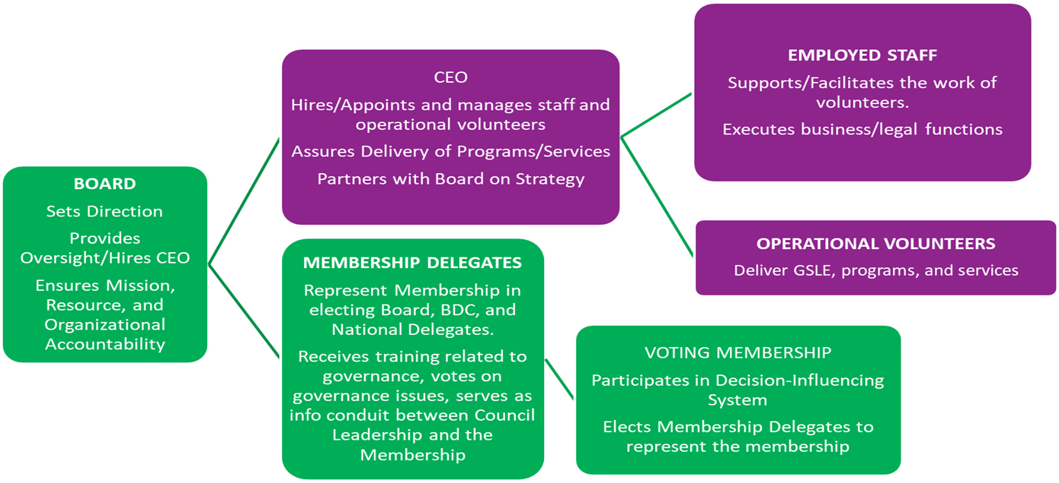
Membership Delegate Role

Slide 11
Representing Your Service Unit
The membership delegate is responsible for:
  Maintaining consistent communication with the Service Unit/Service Unit Director either by phone or email.
  Attending service unit leader meetings as needed.
Information on what to discuss will be provided to delegates, by staff, via conference calls and emails.
A membership delegate must contact GSNEO immediately if she/he is unable to fulfill the responsibilities of the position.

Slide 12
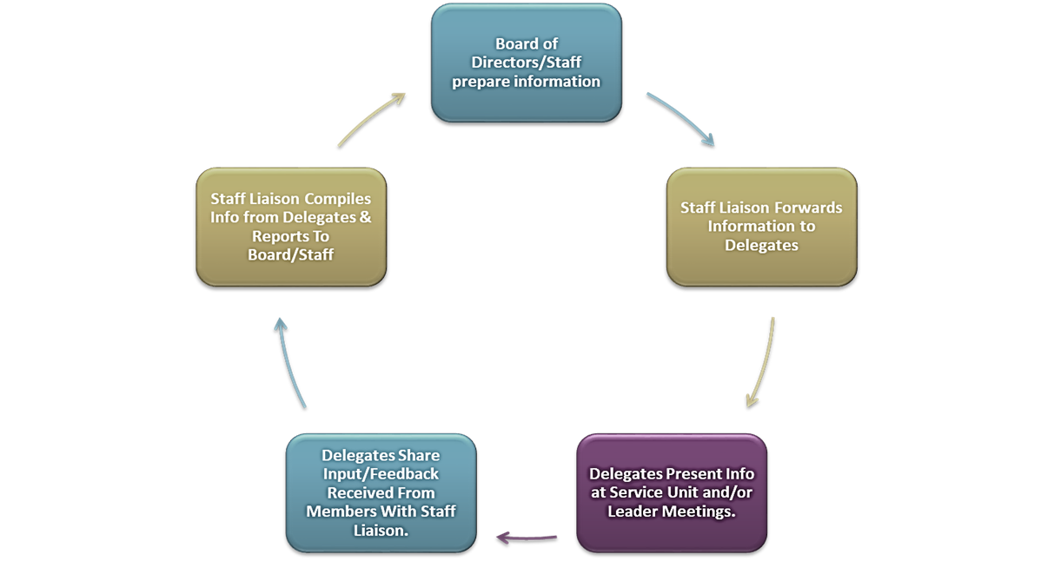
Circle of Communication

Slide 13

Governance Communication Schedule
A minimum of one or two virtual meetings and/or trainings annually. Others will be scheduled as needed.
Annual Meeting of the General Assembly
Virtual Town Hall Meeting as needed.
Updates posted on the GSNEO website on the Governance page.

Slide 14
Blue Book of Basic Documents
Contents Include:
Constitution of Girl Scouts of the United States of America
Bylaws of Girl Scouts of the United States of America
Policies of Girl Scouts of the United States of America
Credentials
Criteria and Standards for an Effective Girl Scout Council
Congressional Charter of Girl Scouts of the United States of America.

Slide 15
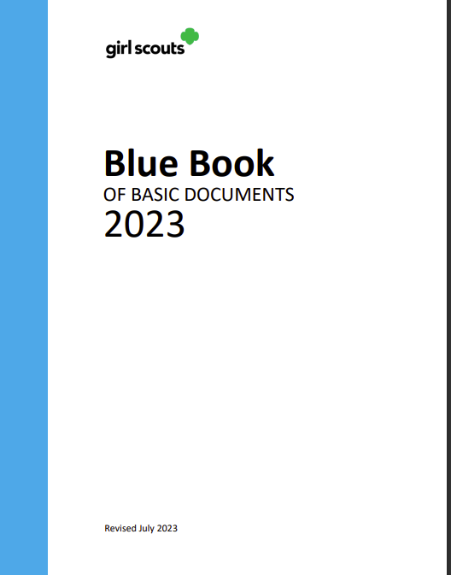
Blue Book Latest Revision: July 2023
Click here for The Blue Book of Basic Documents
on the GSNEO.org website.
Suggestion:
At a future Service Unit Meeting,
share the Blue Book of Basic
Documents!
It a great resource for all of us!

Slide 16

GSNEO Bylaws
The Bylaws, which is the GSNEO Governance Framework answers the following:
  Who is involved in governance of our council
  What is their role and responsibilities
  How do they accomplish their work (chair appointment, election & voting procedures, meetings, etc.)
The GSNEO Bylaws can be found on the GSNEO Governance website page.
The last revision 4/9/22.
Click here for the electronic version of the most current version of the GSNEO Bylaws

Slide 17
Issues that Might be Discussed at a GSNEO Board Meeting
Future funding for the council
Newly adopted or modified corporate goals
GSUSA Initiatives
Potential jurisdiction alteration
Strategy Alignment input

Slide 18
National Delegates

Slide 19
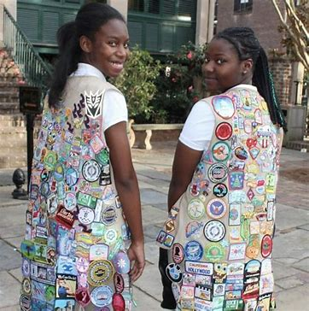
2022– 2024 National Delegates
Currently, GSNEO has 13 National Delegates
7 of the GSNEO’s 13 (54%) National Delegates are GIRLS!
.

Slide 20
National Delegate Major Responsibilities
Participate in council and/or board meetings, and participate in council forums and focus groups, as requested.
Obtain a broad array of the opinions of adult members and Girl Scout Seniors and Ambassadors from all parts of the council.
Participate in teleconferences for voting members, sponsored by the GSUSA.
Engage in opportunities to discuss, learn, and share ideas across the Movement.
Be familiar with the contents of the current Blue Book of Basic Documents.
Have a basic understanding of parliamentary procedure and Robert’s Rules of Order Newly Revised.

Slide 21
National Delegate Major Responsibilities
While attending the National Council Session and any additional special sessions of the National Council each National Delegate is responsible for:
Attending all business meetings and participating in the proceedings.
Being fully prepared to participate in discussion and vote on all business items.
Elect the National Board of Directors, the officers of the National Board of Directors, and the members of the National Board Development Committee.
Determine general lines of policy of the Girl Scout Movement and program by considering and acting upon proposals directed toward the fostering and improvement of Girl Scouting, receiving and acting upon reports from the National Board of Directors, and giving guidance to the National Board upon general lines of direction of the Movement and program.

Slide 22
National Delegate Major Responsibilities
Participate in votes to amend or revise the Constitution and/or the Bylaws of GSUSA.
Participate in the establishment of requirements for certificates of membership, local council charters, and all other credentials.
Submit proposals to the National Council to improve the quality of Girl Scouting, in accordance with the submittal guidelines reflected in Article VI of the Constitution of GSUSA.
Participate in all other action requiring a National Council membership vote.
Wear official Girl Scout uniform during all Convention sessions.

Slide 23
National Delegate Major Responsibilities
Upon returning from the National Council Session, each National Council voting member/delegate is prepared to:
Report on National Council decisions and the reasons for such decisions at the council’s annual meeting, to the council board of directors, and the council’s constituency (if requested by council Board Chair and CEO) on the National Council decisions and the reasons for such decisions.
Share insights on information gained at the National Council Session, if requested.
Assist the council as it prepares to participate in the next National Council Session, if requested.
Participate in teleconferences and other opportunities for voting members/delegates.

Slide 24
GSNEO Annual Meeting of the General Assembly
Hybrid
Virtual Link for Hybrid option will be available soon!
Location:
Sherwood Forest Event Center
Valley View, Ohio
Saturday, April 13, 2024
Review your Call to Meeting for complete details.

Slide 25
Annual Meeting of the General Assembly
Saturday, April 13, 2024
Annual Meeting of the General Assembly Schedule
Location: Sherwood Forest Event Center,
12900 Tinkers Creek Rd, Valley View, Ohio
8:30AM – Doors open, Check-in and Continental Breakfast
9:30 – 11AM – Annual Meeting of the General Assembly
(Required for all voting members of the General Assembly)
Bring your Smartphone, Tablet or iPad for Voting!
Voting link will be emailed the morning of Saturday, April 13th
Special Note:
A celebratory luncheon to honor GSNEO’s 2024 Volunteer Recognition awardees will be held following the Annual Meeting at the same venue from 11:00 AM – 1:00 PM.
Please register for the Annual Meeting of the General Assembly and the Volunteer Recognition Luncheon at your earliest convenience!
.

Slide 26
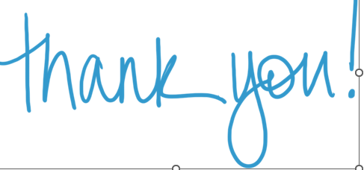
Annual Meeting of the General Assembly
Thank you to Outgoing Directors-at-Large of the Board of Directors:
Judith Matsko, former Board Chair
Nicole Rodenfels
Laura Schultz, former Board Chair
Ellen Stephens
Karen Stock
Chris Venditti
Thank you to Outgoing Girl Board of Director:
  Imani Chamere Ivey
  Thank you to Outgoing Board Development Committee member:
Erin Brady Curtis
Sandee Reid
Karen Stock, Committee Chair
Kim Togliatti-Trickett

Slide 27
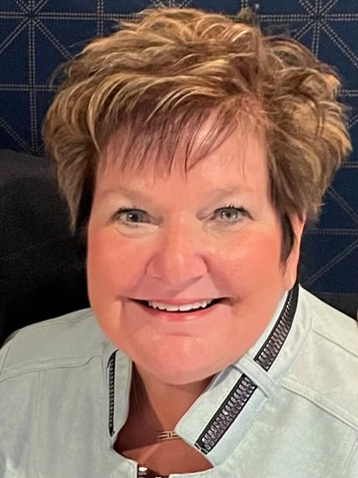
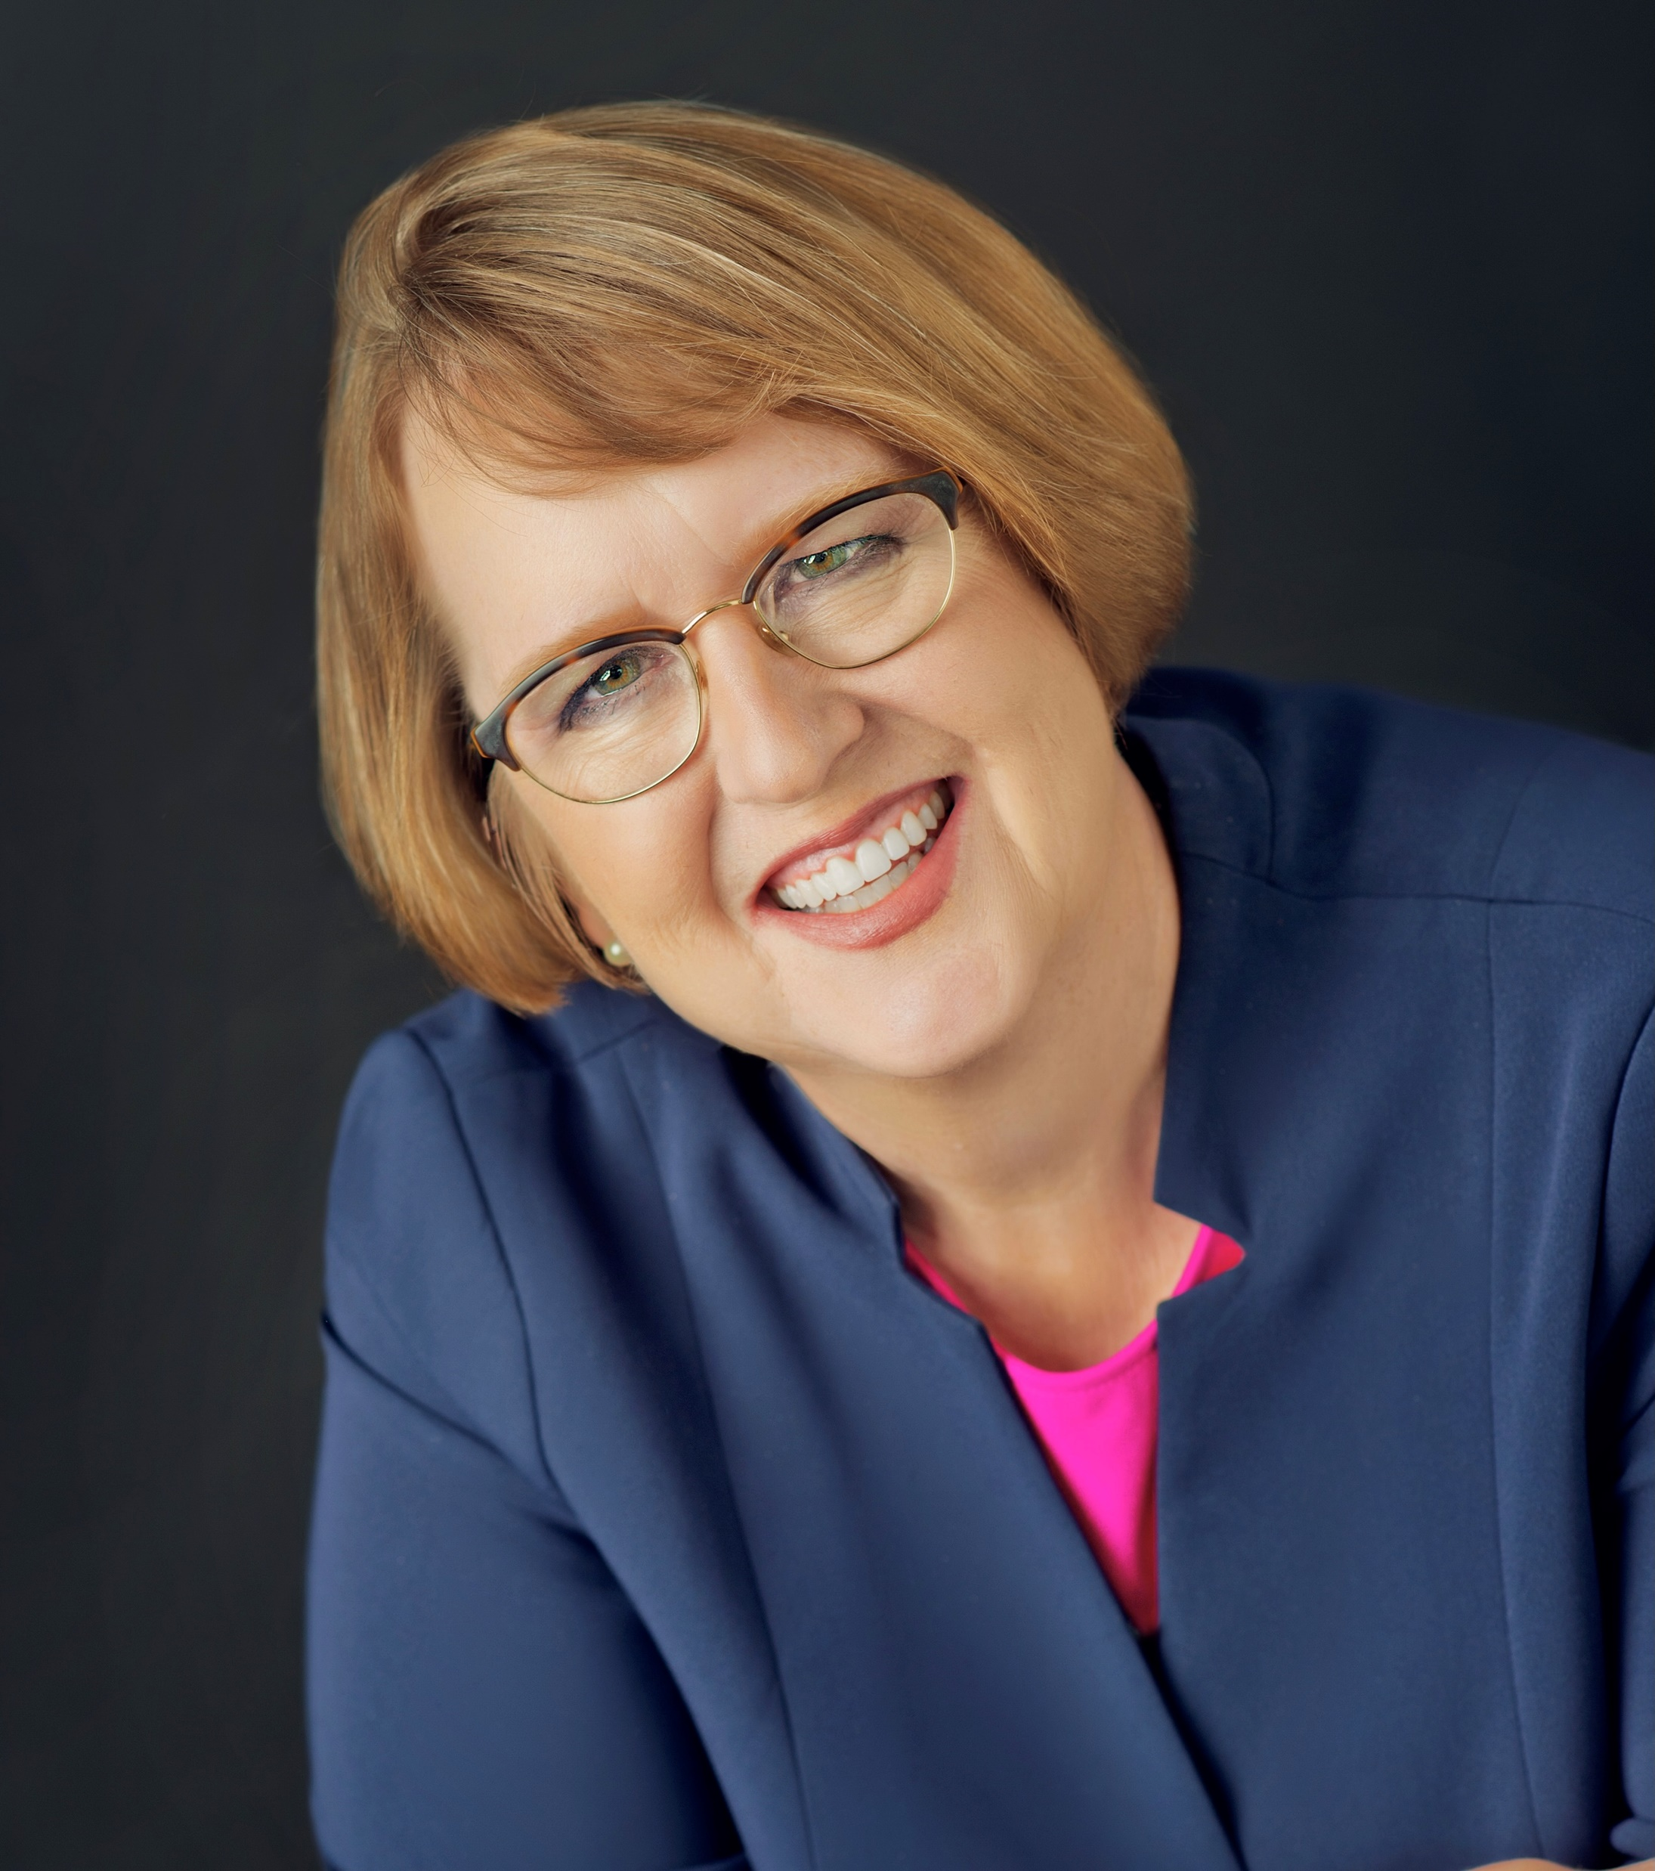
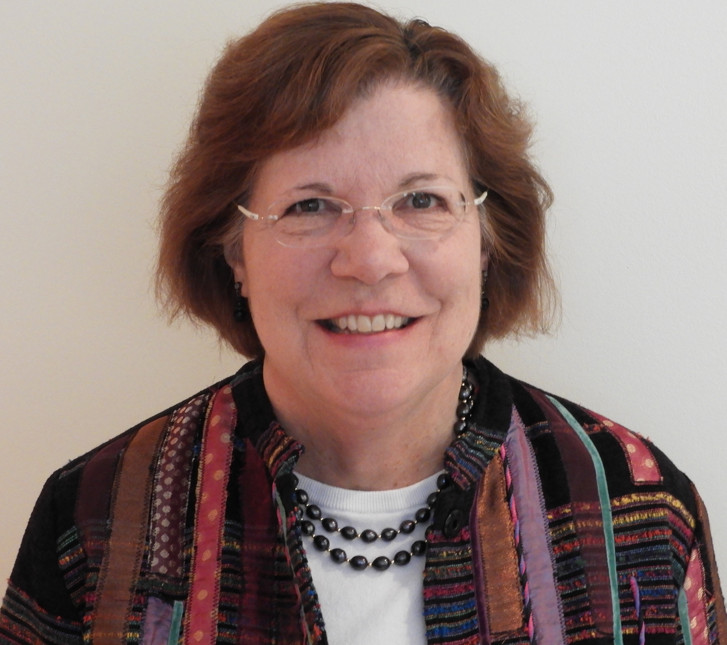
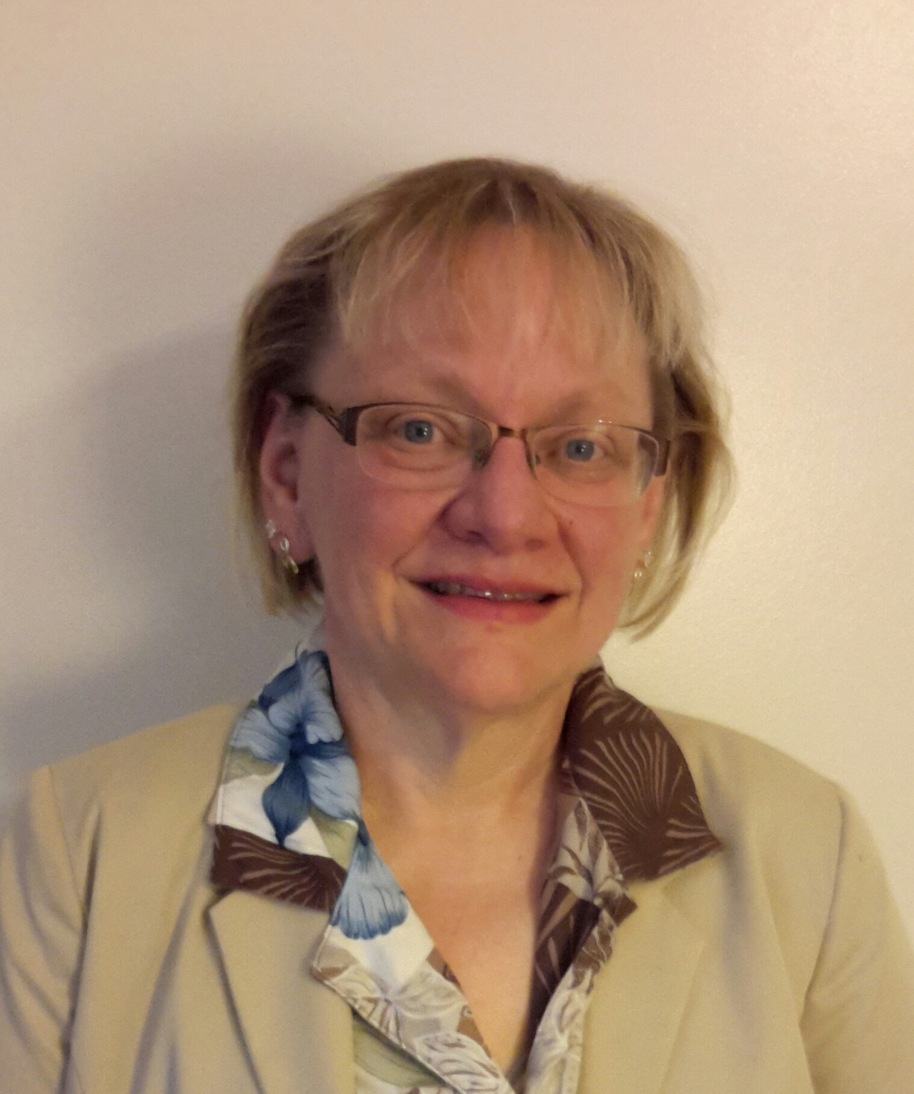
Board Officers Slate – Board of Directors
Sandra Reid
Vice Chair
Davey Tree
Expert Company
Kathy Moock
Chair
Community Volunteer
Kate Asbeck
Treasurer
Retired Financial Executive
Cindy Skelton-Becker
Secretary
Community Volunteer

Slide 28
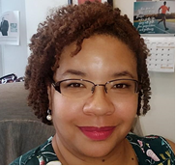
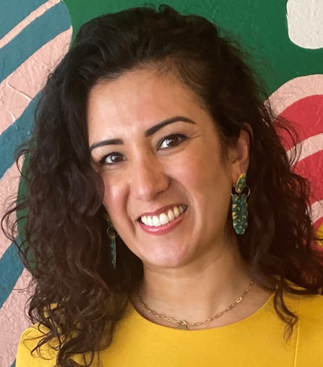
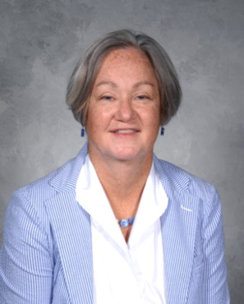
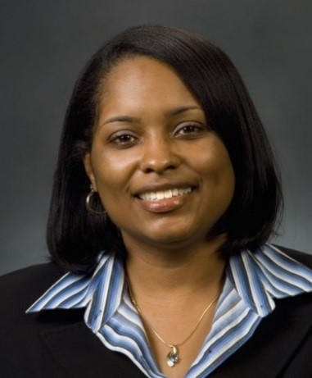
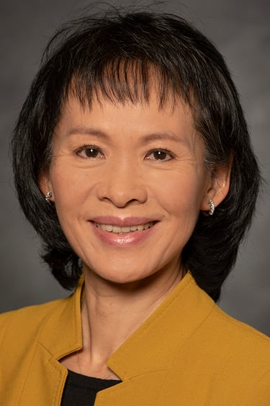
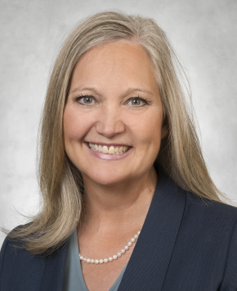
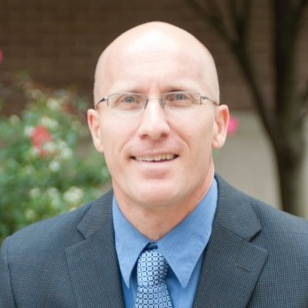
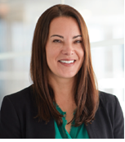
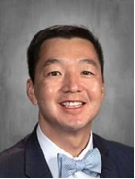
Board of Directors-at-Large Slate (Full Term)
Stephanie Adams
The Sherwin-Williams Company
Ruth Coleman
Retired Business Owner
Claudia Diaz- Singer
The J.M. Smucker Company
Elizabeth Engels
ACER Business Consultants
Robyn Gordon
NASA
Michelle Henry
FirstEnergy
Ka-Pi Hoh
The Lubrizol Corporation
Lisa McKay
Swagelok
Tony Srithai
Beachwood City Schools
Chris Hirschler
Lorain Community College

Slide 29

Board of Directors-at-Large Slate (Unexpired Term)
Rebecca Gallant
Catholic Charities, Diocese of Cleveland

Slide 30
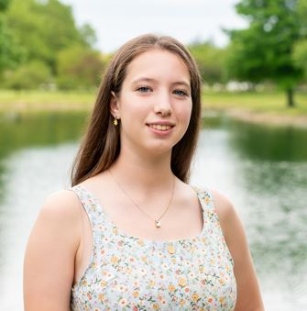
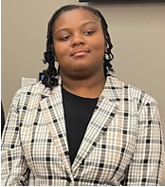
Girl Board Directors-at-Large Slate
Sydney Harbour
Jaiden Miller

Slide 31
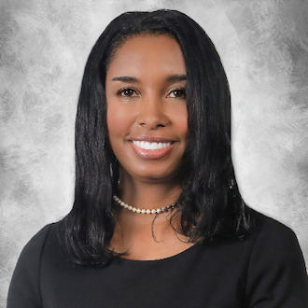
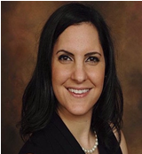
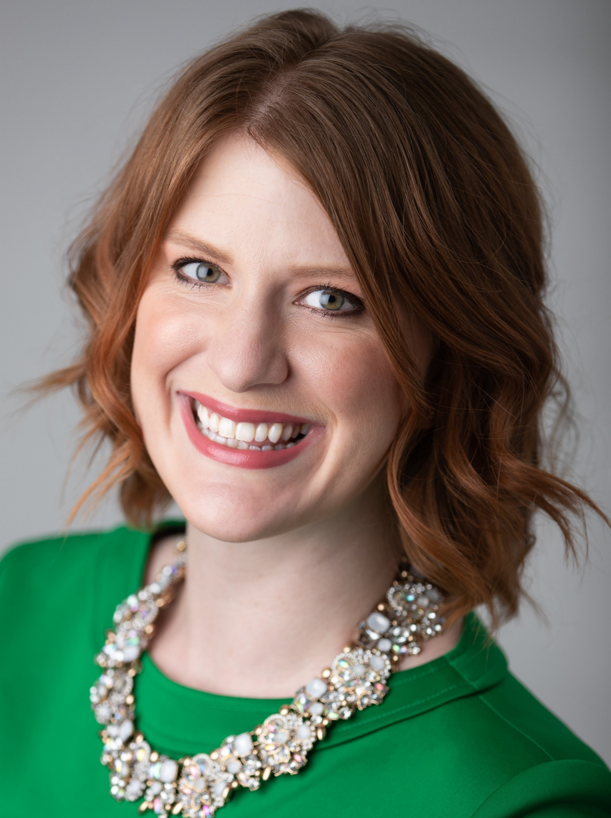
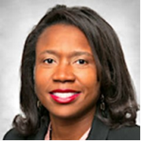
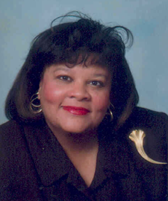
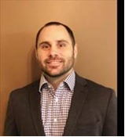
Board Development Committee Slate (Full Term)
Tania Nemer
U.S. Department of Justice
Laura Schultz
Preservation Retirement Services
Tami Bolder
CBIZ Valuation Group
Pamela Valentine
Community Volunteer
Chris Venditti
Moen
Ebony Yeboah Amankwah
Signet Jewelers

Slide 32
GSNEO Bylaws
Proposed Changes

Slide 33
Introduction
The Membership Delegate Voting Proposal Change came from Cadette, Senior, Ambassador Troop 91105 from Service Unit 912.
The girls come from7 different schools in 6 different school districts, and from 5 different towns.
What the troop proposes: The wording of delegate member elections be changed to "all currently registered Girl Scout members aged 14 years or older may vote at a Service unit delegate member meeting for the Service unit that they are associated with or Service unit that their troop is associated with."
This change will allow all registered members 14 years or more to vote in the service unit that they are active with. This will allow for a quorum to be more easily reached, and it will allow for the voice of the members to be heard where they are needed.
The Bylaws Committee met and reviewed the proposal and agrees. The following slides provides their proposal with simplified language along with the rationale.

Slide 34
Bylaws of GIRL SCOUTS OF NORTH EAST OHIO Council of
Girl Scouts of the United States of America
Article IV – General Assembly
Section 2 Membership Delegate Elections
The Council shall establish geographic subdivisions within the jurisdiction. Each geographic subdivision shall be termed a Service Unit.
Individuals age 14 years of age and over who are currently registered Girl Scouts through and in good standing with the Council shall be a registered member of a Service Unit. A person may be a member of only the Service Unit in which he/she/they reside.
The members residing within a specific of a Service Unit shall elect representation in the form of a Membership Delegate, to the General Assembly of the Council. If the Membership Delegate elected by the Service Unit is a girl delegate then the Service Unit shall be entitled to elect a 2nd Membership Delegate.
Each Service Unit Member, age 14 and older, attending a Membership Meeting in a Service Unit shall be entitled to one (1) vote. A Service Unit Member shall vote in only one (1) Service Unit. Elections shall be by show of voting cards or other means in uncontested elections. In the event of a contested election, those positions shall be elected by ballot vote. A majority shall elect. No proxy votes shall be permitted.

Slide 35
Bylaws of GIRL SCOUTS OF NORTH EAST OHIO Council of
Girl Scouts of the United States of America
Rationale:
This change would allow an individual who is active with their troop in a service unit where they do not reside, to be a member of the service unit they are active in, instead of the service unit they reside in. Section 2 D still allows only ONE vote in ONE service unit per individual.

