Slide 1
Welcome

Slide 2
Call to Order
Notes:
Good morning and welcome Girl Scouts.
I am Judith Matsko, GSNEO Board Chair. The 2021 Girl Scouts of North East Ohio Annual Meeting, of the General Assembly – Part 1 will come to order.
At this time, I ask that you mute yourself on Zoom, please. Thank you.
As a result of the ongoing COVID-19 Pandemic Crisis, the Annual Meeting of the General Assembly will be conducted via Zoom in two parts today as we have communicated.

Slide 3
Judith Matsko
Board Chair
Notes:
I first want to thank you for taking time to participate in the Annual Meeting.
It is an honor and privilege to serve as Chair of the GSNEO Board of Directors
As Board Chair, I have the good fortune to work with very committed and dedicated volunteers.
Please accept my heartfelt gratitude.
While we may not always think of nonprofit board service when we consider volunteerism … it is in fact a voluntary role.
Serving as Chair of the Board of Directors, is the single, best way that I can spend my time helping girls reach their full potential.
As a member of a dedicated team, we identify long-term goals, seek out diverse opportunities for collaboration, and brainstorm – as well as implement innovative strategies to make a lasting and positive impact.
So I thank you-each one of my colleagues-as well as those of you who served before us, for setting a shining example!
Nothing great is accomplished alone.
With our skilled staff and devoted volunteers, we have accomplished many great things this past year during an unprecedented pandemic. …
You will hear more about those accomplishments in the different reports during Part 2 of today’s Annual Meeting that is open to all Voting and Non Voting Members.
I want to quickly remind our members of the Board of Directors (including our Girl Board Members), Board Development Committee, Membership Delegates, and National Delegates that you received a secure Qualtrics link for voting purposes for our various slates.

Slide 4
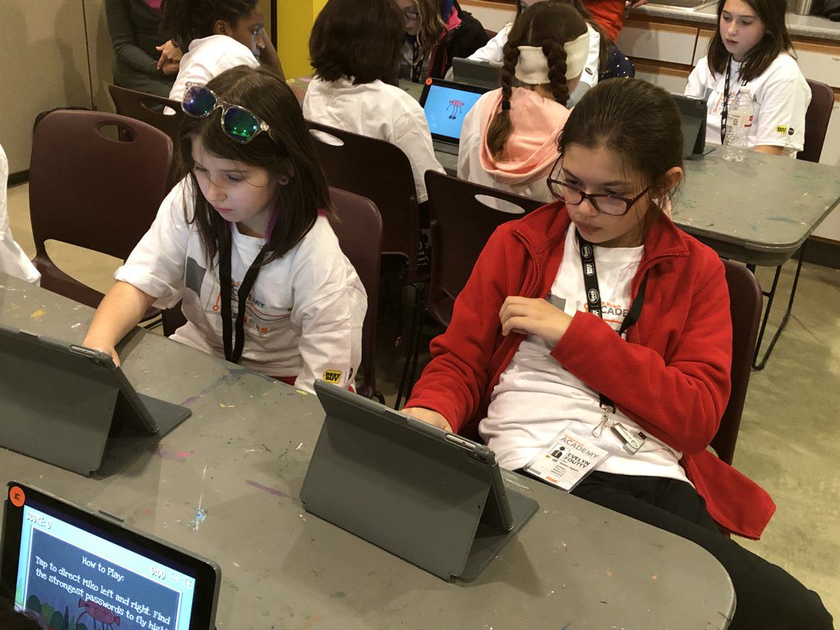
Gratitude
Board of Directors
Board Development Committee
Jane Christyson, CEO
Membership Delegates
National Delegates
Notes:
I would like to thank: Board of Directors – Chris Venditti, Vice Chair; Cindy Skelton-Becker, Secretary and Kate Asbeck, Treasurer and Directors-at-Large: Allison Baker,
Dr. Diana Bilimoria, Robyn Gordon, Joseph Gutkoski, Matt Inks, Kathy Moock,
Dr. Mary Parker, Sandra Rapp, Nicole Rodenfels, Laura Schultz, Dr. Karen Stock, Ellen Stephens, Chris Walker, Kristina Wilson and Christine Young and our Girl Board of Directors: Charity Boley and Ava Kress.
We also express our gratitude to the hard work of the Board Development Committee – Kathy Moock, Chair; Erin Brady Curtis, Julie Cruz Blair, James Harris, Kaitlyn Pillar, Sandra Reid, Dr. Karen Stock, and Dr. Vivian von Gruenigen.
Our thanks to our National and Membership delegates who are the pulse and heartbeat of our Council.

Slide 5
Retiring
Adult Board of Directors
Joseph Gutkoski, Esq.
Dr. Mary Parker
Kristina Wilson
Girl Board of Directors
Charity Boley
Ava Kress
Board Development Committee
Julie Cruz Blair
Dr. Vivian von Gruenigen
Notes:
We would like to thank the following board and board development committee members who are retiring from their board level service
Adult Board of Directors
Joseph Gutkoski, Esq.
Dr. Mary Parker
Kristina Wilson
Girl Board of Directors
Charity Boley
Ava Kress
Board Development Committee
Julie Cruz Blair
Dr. Vivian von Gruenigen
You will be receiving a token of appreciation for your commitment and service to GSNEO.

Slide 6
In Gratitude
On behalf of all of us I would like to extend our gratitude to our beloved CEO, Jane Christyson, who leads a great team of dedicated professionals who work tirelessly on behalf of our girls!
Thank you to our Membership Delegates, who work very hard to make sure there is open communication between constituents and the leadership team.
Thank you also to our National Delegates, who participated on the 2020 National Council Session virtually and will be continuing their service for another year.
Notes:
On behalf of all of us I would like to extend our gratitude to our beloved CEO, Jane Christyson, who leads a great team of dedicated professionals who work tirelessly on behalf of our girls!
Thank you to our Membership Delegates, who work very hard to make sure there is open communication between constituents and the leadership team.
Thank you also to our National Delegates, who participated on the 2020 National Council Session virtually and will be continuing their service for another year.

Slide 7
Annual Meeting of the General Assembly – Part 1
Procedures for the Annual Meeting, Part 1
Due to the ongoing COVID-19 Pandemic, today’s Annual Meeting will be divided into two parts.
Part 1 –Voting Members of the General Assembly Only
Elections via Qualtrics:
Adult Board of Directors
Girl Board of Directors
Board Development Committee Members (Full Term)
Board Development Committee Member (Unexpired Term)
Notes:
Annual Meeting of the General Assembly – Part 1
Today’s Annual Meeting, Part 1 has been organized as a Zoom Meeting while Part 2 is set up in Webinar mode. The slides and recording for both will be posted in the coming week on the GSNEO Governance Page.

Slide 8
Annual Meeting of the General Assembly – Part 2
Part 2 –Open to Voting and Non-Voting Members
Welcome and Call to Order – Judith Matsko, Board Chair
Treasurer Report – Kate Asbeck, Treasurer, Board of Directors
Committee Reports
Audit & Risk Management – Sandra Rapp
Community Engagement– Laura Schultz, Esq. and Allison Baker, Committee Co Chairs
Properties – Cindy Skelton-Becker, Committee Chair
Strategic Alignment – Matt Inks, Committee Chair
STEM Advisory – Dr. Diana Bilimoria, Ph.D., Committee Chair
Operations Report – Jane Christyson, CEO
New Business
Questions and Answers
Quorum Report and Election Results – Roxanne Base, Ph.D., Research Analyst
Adjournment – Judith Matsko, Board Chair
Notes:
Part 2 will consist of Committee Reports and an Operational Report as well as time for questions and answers.

Slide 9
Establishment of Quorum
If you have a question or comment, please raise your hand and you will be unmuted or type in the chat log.
For quorum purposes, please raise your hand.
Each voting member should vote separately via the Qualtrics link for quorum purposes.
According to the Girl Scouts of North East Ohio Bylaws, Article IV, Section 1 – Voting members of the General Assembly shall consist of: All voting members of the Board of Directors; All Girl Board of Directors-at-Large; All voting members of the Board Development Committee; Membership Delegates; and National Delegates and Alternate National Delegates.
Notes:
Read this slide

Slide 10
Establishment of Quorum (cont’d)
Per Article V, Section 1 –Thirty-five (35) voting members of the Council shall be present to constitute a quorum for the transaction of business, provided that at least twenty-three (23) of the voting members present are Membership Delegates.
Due to today’s meeting being virtual, the Quorum Report will be established by Qualtrics voting link and will be delivered during the Annual Meeting, Part 2 session.
Any questions?
Notes:
Read this slide

Slide 11
Adoption of Agenda
Notes:
We will now proceed to voting on the Adoption of the Meeting Agenda.
The Agenda was distributed on March 10, 2021.
Are there any objections to the Adoption of the Agenda as presented?
(Note: Objections can be either by typing their name and objection in the Chat Log, Raising hand in the lower right-hand corner or unmuting themselves.
If there is no objection, the Agenda will be adopted as presented.
Pause
Hearing none, please raise your hands in lower right-hand corner of your screen that you are in favor of the Adoption of the Agenda as presented.
Just in case: Do not read unless needed)
A majority of the membership voting in favor will approve the agenda as presented.
(Or a motion – in writing – to amend the proposed amended agenda).
The written motion will be given to the chair and secretary. (Second required) (Please refer to other document for amendments to agenda process.
Chair: (states the motion as written by the maker)
It is moved and seconded that the proposed agenda be
amended as follows:(states the motion as written by the
maker in its entirety.)
Is there any debate?
(debate can also include another amendment to the primary
amendment. Please wait to be recognized by the chair, to
speak. Please state your name and whether you are speaking
for or against the motion.
Please wait to be recognized by the chair, to speak. Please
state your name and whether you are speaking for or against
the motion.
Voting Members will be recognized by the chair and you are
asked to state your name, Position and/or Service Unit and if
you are speaking “for” or “against” the motion.
Please remember that your comments must be confined to
the merits of the motion on the floor.
15 minutes
Is there further debate?
(Alternate between for and against)
(The question is on the adoption of the amendment to:
restate the amendment in its entirety.)
Is there a second? <Pause>
If no one seconds, ask for a second immediately after the
motion is made! If no 'second.' The chair says that the motion
is not before the assembly for voting.
Thank you for your cooperation. We will now proceed to
voting on the Adoption of the Meeting Agenda.
Take the vote by a show of hands in right hand corner.

Slide 12
Judith Matsko
Board Chair
Notes:
We will now move on to the Elections.
Before I turn the meeting over to the Board Development committee, I would like to share with you the role and responsibilities of this committee for providing a slate of nominees for this election from the Girl Scout of North East Ohio Bylaws, adopted April 7, 2018.
The responsibilities of the Board Development
Committee shall be:
A. to recruit, review and confirm the qualifications of candidates for elected positions;
B. to provide to the General Assembly a slate of one candidate for each position to be elected including: Officers, Directors-at-Large, Girl-Directors-at-Large, Board Development Committee Members and delegates and alternate to the National Council of Girl Scouts of the United States of America; The Board Development Committee is charged with finding the most qualified candidates to serve our Council at the highest capacity. Many factors are taken into account including: geographic representation, age, race, gender, diversity, ability to raise funds and the profile of GSNEO, ability to connect GSNEO with economic resources, contribute at a personal level, professional expertise in finance, operations, fund development, and marketing and the willingness to support and promote the Girl Scout Leadership Experience, the Mission and purpose.
GSUSA also finds this work highly important. They note that we need recognized leaders in various fields, who have the vision and strategic thinking to lead in a period of transformation. We should seek top-level executives, entrepreneurs, educators, officials, and other recognized leaders, in particular those who are experts on the issues facing girls today.
Of course, commitment to the Mission, vision and Girl Scout Leadership Experience is a must as well. Girl Scouts is fully committed to diversity and seeks candidates of diverse backgrounds.
I ask that you please give your attention to Kathy Moock, Board Development Committee Chair.

Slide 13
Elections
Kathy Moock
Chair, Board Development Committee
Notes:
This year, the Board Development Committee was comprised of an excellent group of committee members who had the best interests of GSNEO in mind. as we prepared the slate
for this election. The work of our committee was challenging, and many factors were taken into consideration.
We conducted a complete evaluation of our current board, examining each member's skill sets, knowledge, and expertise. We then compared the results against the objectives of our strategic plan. This comparison gave us insight into areas where we needed to build our expertise, such as fund development, collaborative partnerships, education, marketing, and community relations, giving us a road map toward selecting the best candidates.
We are very proud of our work and believe the slated nominees possess the aptitude, experience and skills necessary to continue to move our organization forward.
Candidate Profiles were sent out with the Call to Meeting. Now is the time to vote if you haven’t already done so, you should’ve received the link in your email at 9:00 this morning.
We received ZERO floor nominations. What does that mean? Only explain if someone asks.
Our Bylaws state in Article X, Section 6 Nominations from the General Assembly
When balloting for elected positions shall be done in person at the Annual
Meeting, nominations for any of the elected positions may be made by voting members of the General Assembly provided: the individual to be nominated has
consented in writing to serve if elected; the nomination has been submitted in a form approved by the Board of Directors to the Chair of the Board Development Committee, or his/her designee, at least five (5) days before the convening of the Annual Meeting; the individual to be nominated has submitted the written endorsement of at least three (3) voting members of the General Assembly; the prospective nominee meets the qualifications for the office for which she/he is being nominated as specified in the written application materials provided by the
Board Development Committee. Each election category is a separate vote for the adoption of that respective slate. is correct before submitting your Qualtrics ballot.
Once submit your vote via Qualtrics , it is cast and cannot be changed.
Are there any questions?

Slide 14
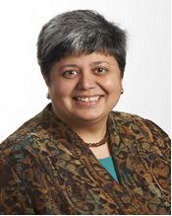
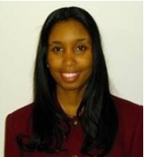
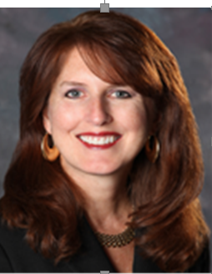
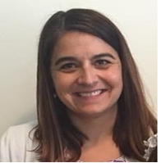
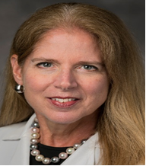
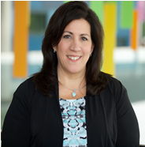
Adult Directors-at-Large Slate – Full Term (Board of Directors)
Diana Bilimoria, Ph. D
Case Western Reserve University
Tami Bolder
CBIZ Valuation Group
Sandra Rapp
TravelCenters of America
Heather Valentino
Greater Cleveland Regional Transit Agency
Christine Young.
MSN, MBA, RN, NEA-BC
Akron Children’s Hospital
Vivian von Gruenigen, M.D. NEOMED
Notes:
Next is the election of the Board of Directors-at-Large (Full Terms).
Diana Bilimoria, Ph.D.
Tami Bolder
Sandra Rapp
Heather Valentino
Vivian con Gruenigen, M.D.
Christine Young

Slide 15
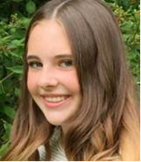
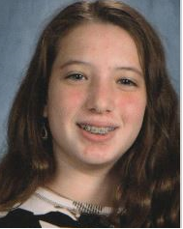
Girl Board Directors-at-Large
Shelby Bennett
Sydney Harbour
Notes:
Next is the election of the Girl Board of Directors-at-Large
Shelby Bennett
Sydney Harbour

Slide 16
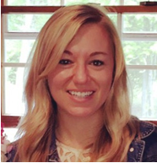
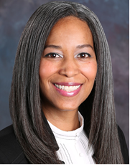
Board Development Committee (Full Term)
Kaitlyn Pillar
Progressive Insurance
Angel Williams
The Timken Company
Notes:
Next is the election of the Board Development Committee (Full Terms)
Kaitlyn Pillar
Angel Williams

Slide 17
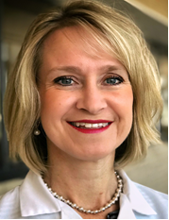
Board Development Committee (Unexpired Term)
Kimberly Togliatti-Trickett, M.D.
University Hospitals Parma Medical Center
Notes:
Next is the election of the Board Development Committee (Unexpired Term) .
Kimberly Togliatii-Trickett, M.D.

Slide 18
Judith Matsko
Board Chair
Notes:
Thanks Kathy!

Slide 19
Zoom Information for Annual Meeting, Part 2
Open to Voting and Non-Voting Members
Part 2 – 10:30am (Voting and Non-Voting Members) – Please Register
If you haven’t already done so, please click on the link to register: https://zoom.us/webinar/register/WN_WHh5EKeiQTWB2FTCUbEHng
After registering, you will receive a confirmation email containing information about joining the webinar for Part 2 of the Annual Meeting of the General.
The presentation and recording of the meeting will be poste don our website afterwards.
Live Chat are available to assist you!
Notes:
For your convenience, we are displaying the Zoom information for the second part of the Annual Meeting.
Part One will end now and we will begin Part 2 at 10:30 am.
This information was sent out in advance of the meeting and can also be found on the Governance Page of the GSNEO website.
Thank you for your attention.

Slide 20
Adjournment
Annual Meeting, Part 1
Notes:
Ask for a motion to Adjourn the Meeting

